Slide 1

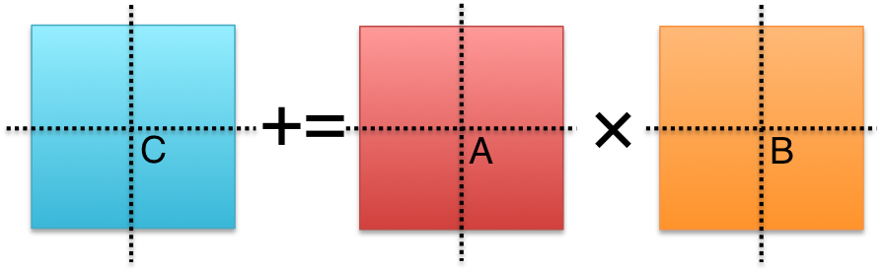


High-performance Implementations of Fast Matrix Multiplication with Strassen’s Algorithm
STRASSEN
Jianyu Huang, Tyler Smith, Greg Henry, Robert van de Geijn
Notes:
Good afternoon.

Slide 2

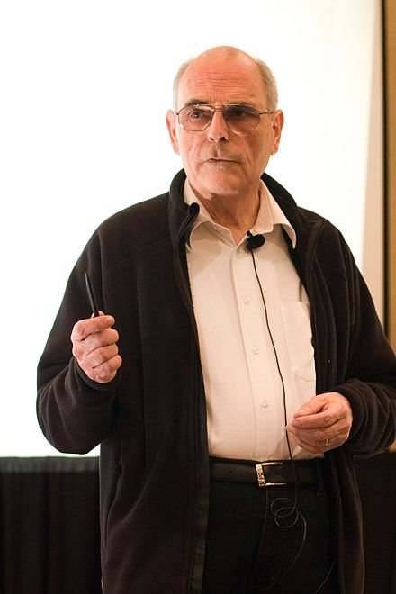
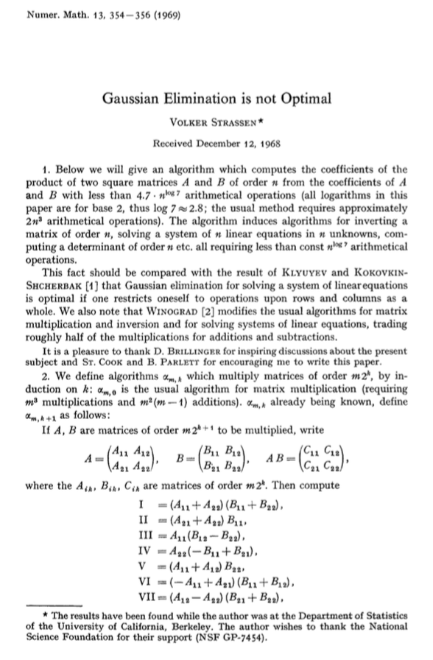
*Overlook of the Bay Area. Photo taken in Mission Peak Regional Preserve, Fremont, CA. Summer 2014.
STRASSEN, from 30,000 feet
Volker Strassen
(Born in 1936, aged 80)
Original Strassen Paper (1969)
Notes:
(click)
Strassen algorithm was first published in 1969. The original paper demonstrates that we can perform matrix multiplication with less than O(n^3) floating point operations required by a classical matrix multiplication.
(Significance):
It has led to many theoretical improvements based on this result, as well as practical implementations. (Paper List? Complexity table?)
To start, I will give a 30,000 feet overview about the original Strassen algorithm, in theory and in practice.

Slide 3
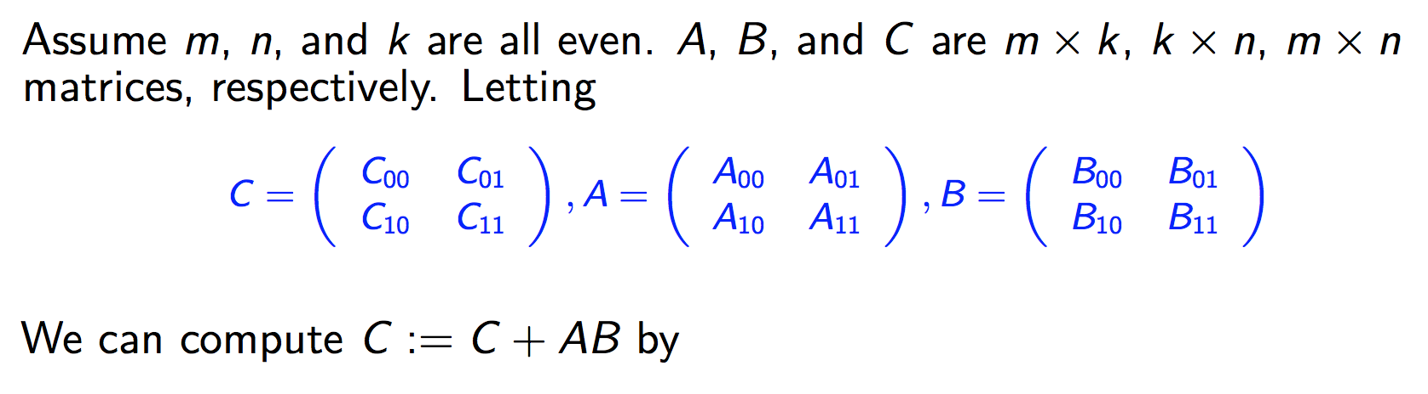
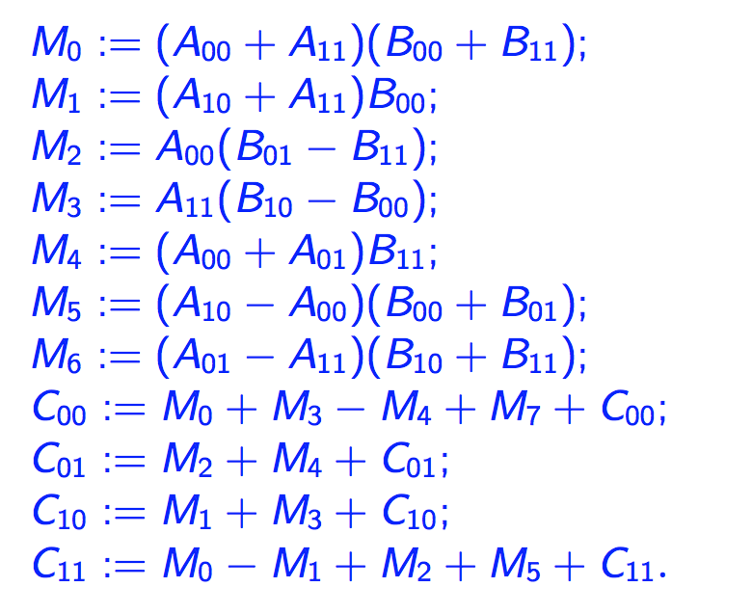
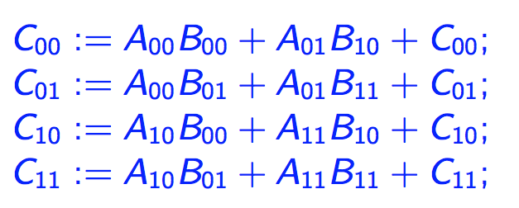
One-level Strassen’s Algorithm (In theory)
Direct Computation
Strassen’s Algorithm
8 multiplications, 8 additions
7 multiplications, 22 additions
*Strassen, Volker. "Gaussian elimination is not optimal." Numerische Mathematik 13, no. 4 (1969): 354-356.
Notes:
The general idea about Strassen algorithm is relatively simple.
We can compute the matrix multiplication by slice and dice each matrix into 2x2 submatrices.
(click)
The standard matrix multiplication computes submatrix multiplication directly, with 8 matrix multiplications and 8 matrix additions.
(click)
With Strassen’s algorithm, we can compute the same problem with only 7 multiplications and 22 additions.
Because theoretically matrix multiplication cost O(n^3), while matrix addition cost O(n^2) term.
We shift the computations from multiplications to additions, reducing the O(n^3) term at the expense of adding O(n^2) complexity.
This is just for one-level Strassen.

Slide 4
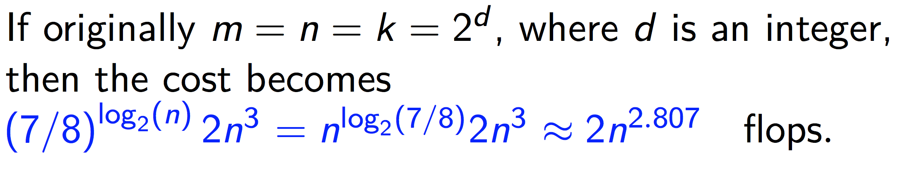
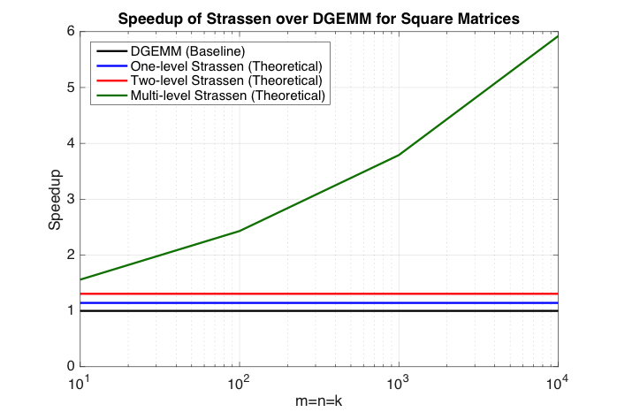
Multi-level Strassen’s Algorithm (In theory)
M₀ := (A₀₀+A₁₁)(B₀₀+B₁₁);
M₁ := (A₁₀+A₁₁)B₀₀;
M₂ := A₀₀(B₀₁–B₁₁);
M₃ := A₁₁(B₁₀–B₀₀);
M₄ := (A₀₀+A₀₁)B₁₁;
M₅ := (A₁₀–A₀₀)(B₀₀+B₀₁);
M₆ := (A₀₁–A₁₁)(B₁₀+B₁₁);
C₀₀ += M₀ + M₃ – M₄ + M₆
C₀₁ += M₂ + M₄
C₁₀ += M₁ + M₃
C₁₁ += M₀ – M₁ + M₂ + M₅
One-level Strassen (1+14.3% speedup)
8 multiplications → 7 multiplications ;
Two-level Strassen (1+30.6% speedup)
64 multiplications → 49 multiplications;
d-level Strassen (n³/n^{2.803} speedup)
8^{d} multiplications → 7^{d} multiplications;
Notes:
(click)
Asymptotically the one-level Strassen is 14% faster than the standard matrix multiplication, because 8 -> 7 (reduce).
(click)
If we compute the intermediate result Mi with another level of Strassen, we can get two-level Strassen. That is 30% faster than the standard matrix multiplication. 64->49
(click)
If we do it recursively until the subproblem size becomes 1, we can get multi-level Strassen. We can prove that the whole process can be finished with O(n^2.807) floating point operations.
(click)
This picture shows the theoretical speedup of different levels of Strassen algorithm over DGEMM, which represents the standard matrix multiplication. The x-axis is a log scale of problem size. The y-axis is the speedup.
--The black line is always 1, represents the standard matrix multiplication.
--The blue and red line shows the theoretical speed up of one and two level Strassen.
--The green line shows the theoretical speed up for multi-level Strassen.

Slide 5
Multi-level Strassen’s Algorithm (In theory)
M₀ := (A₀₀+A₁₁)(B₀₀+B₁₁);
M₁ := (A₁₀+A₁₁)B₀₀;
M₂ := A₀₀(B₀₁–B₁₁);
M₃ := A₁₁(B₁₀–B₀₀);
M₄ := (A₀₀+A₀₁)B₁₁;
M₅ := (A₁₀–A₀₀)(B₀₀+B₀₁);
M₆ := (A₀₁–A₁₁)(B₁₀+B₁₁);
C₀₀ += M₀ + M₃ – M₄ + M₆
C₀₁ += M₂ + M₄
C₁₀ += M₁ + M₃
C₁₁ += M₀ – M₁ + M₂ + M₅
One-level Strassen (1+14.3% speedup)
8 multiplications → 7 multiplications ;
Two-level Strassen (1+30.6% speedup)
64 multiplications → 49 multiplications;
d-level Strassen (n³/n^{2.803} speedup)
8^{d} multiplications → 7^{d} multiplications;
Numerical stability:
*Grey Ballard, Austin R. Benson, Alex Druinsky, Benjamin Lipshitz, and Oded Schwartz. "Improving the numerical stability of fast matrix multiplication algorithms." arXiv preprint arXiv:1507.00687 (2015).
*James Demmel, Ioana Dumitriu, Olga Holtz, and Robert Kleinberg. "Fast matrix multiplication is stable." Numerische Mathematik 106, no. 2 (2007): 199-224.
*Nicholas J. Higham, Accuracy and stability of numerical algorithms. SIAM, 2002.
Notes:
People may be concerned about the numerical stability of Strassen’s aglorithm, because with the matrix subtraction here, the catastrophic cancellation may happen.
Recent research reveals that Strassen algorithm is not that numerical unstable.
numerical stability will only degrade a little if we only incorporate a few levels of recursions,
and the matrix itself has some structure patterns.
These patterns are actually common in the real-world applications.
This is beyond the range of my talk.
The important point of this slide is to show the huge impacts for using Strassen algorithm to accelerate matrix multiplication.

Slide 6
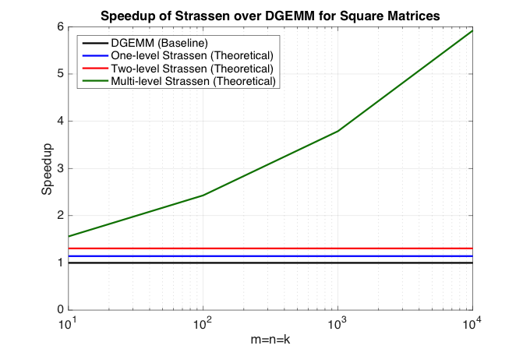
Strassen’s Algorithm (In practice)
M₀ := (A₀₀+A₁₁)(B₀₀+B₁₁);
M₁ := (A₁₀+A₁₁)B₀₀;
M₂ := A₀₀(B₀₁–B₁₁);
M₃ := A₁₁(B₁₀–B₀₀);
M₄ := (A₀₀+A₀₁)B₁₁;
M₅ := (A₁₀–A₀₀)(B₀₀+B₀₁);
M₆ := (A₀₁–A₁₁)(B₁₀+B₁₁);
C₀₀ += M₀ + M₃ – M₄ + M₆
C₀₁ += M₂ + M₄
C₁₀ += M₁ + M₃
C₁₁ += M₀ – M₁ + M₂ + M₅
Notes:
However, we cannot match the reality to our expectations with the conventional implementations of Strassen algorithm.
The conventional implementations recursively perform a few levels of Strassen and then invoke traditional DGEMM.
1. With this approach, we need substantial workspace:

Slide 7
Strassen’s Algorithm (In practice)
T₀
T₁
M₀ := (A₀₀+A₁₁)(B₀₀+B₁₁);
M₁ := (A₁₀+A₁₁)B₀₀;
M₂ := A₀₀(B₀₁–B₁₁);
M₃ := A₁₁(B₁₀–B₀₀);
M₄ := (A₀₀+A₀₁)B₁₁;
M₅ := (A₁₀–A₀₀)(B₀₀+B₀₁);
M₆ := (A₀₁–A₁₁)(B₁₀+B₁₁);
C₀₀ += M₀ + M₃ – M₄ + M₆
C₀₁ += M₂ + M₄
C₁₀ += M₁ + M₃
C₁₁ += M₀ – M₁ + M₂ + M₅
T₂
One-level Strassen (1+14.3% speedup)
7 multiplications + 22 additions;
Two-level Strassen (1+30.6% speedup)
49 multiplications + 344 additions;
d-level Strassen (n³/n^{2.803} speedup)
Numerical unstable; Not achievable
T₃
T₄
T₅
T₆
T₇
T₈
T₉
Notes:
For example,
we need to use T0 -> A00 + A11, T1 -> B00 + B11, and M0 ->T0 * T1.
We have to explicitly form a workspace for T0 to T9, and M0 to M6.
Although a careful reordering of these computations can reduce the additional workspace buffer to only two submatrices,
That still limits the problem size.
Moreover, it makes the implementation not plug-compatible with the GEMM interface, because we have to pass in such workspaces.
2. A second concern is the additional memory movement
(click)
--For one-level Strassen, besides 7 multiplications, we need 22 additions;
(click)
--For two-level Strassen, besides 49 multiplications, we need 344 additions;
The constant before O(n^2) term for matrix addition is relatively large.

Slide 8
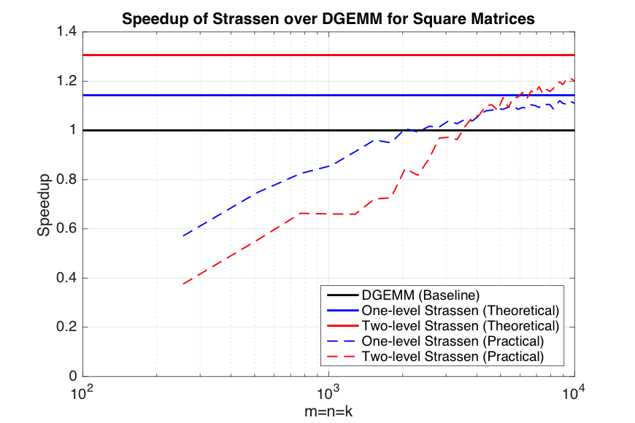

Strassen’s Algorithm (In practice)
T₀
T₁
M₀ := (A₀₀+A₁₁)(B₀₀+B₁₁);
M₁ := (A₁₀+A₁₁)B₀₀;
M₂ := A₀₀(B₀₁–B₁₁);
M₃ := A₁₁(B₁₀–B₀₀);
M₄ := (A₀₀+A₀₁)B₁₁;
M₅ := (A₁₀–A₀₀)(B₀₀+B₀₁);
M₆ := (A₀₁–A₁₁)(B₁₀+B₁₁);
C₀₀ += M₀ + M₃ – M₄ + M₆
C₀₁ += M₂ + M₄
C₁₀ += M₁ + M₃
C₁₁ += M₀ – M₁ + M₂ + M₅
T₂
One-level Strassen (1+14.3% speedup)
7 multiplications + 22 additions;
Two-level Strassen (1+30.6% speedup)
49 multiplications + 344 additions;
d-level Strassen (n³/n^{2.803} speedup)
Numerical unstable; Not achievable
T₃
T₄
T₅
T₆
T₇
T₈
T₉
Notes:
Here we zoom in the small region of performance graph we show in the previous slide.
The blue/red dashed line is the practical performance curve for 1/2-level Strassen on single core;
Gap is huge, especially for small problem size.
Note that the practical Strassen implementation cannot outperform the standard matrix multiplication until the problem size is as large as 2000.
(click)
--For multi-level Strassen, there are two issues here.
--it is numerical unstable to have too many levels of recursions;
--even for three-level Strassen, cross point -> huge; exceed the memory size of the machine.
Therefore, the green line here is not achievable in practice.
The important point for this slide is that
Even with one or two level Strassen, it is only practical for very large square matrix.

Slide 9


To achieve practical high performance
of Strassen’s algorithm…...
Conventional Implementations
Our Implementations
Matrix Size
Must be large
Matrix Shape
Must be square
Memory movement
No Additional
Workspace
Padding
Buffers
Parallelism
Notes:
In summary, to achieve the practical high performance of Strassen’s algorithm, the conventional implementations, just invoke DGEMM, as the recursive base step, for 1 or 2 levels of recursions.
(click)
The matrix size must be large enough so that it can outperform the standard matrix multiplication
(click)
2. The matrix shape must be square.
(click)
3. We need to pass in additional Workspace, which make Strassen not plug-compatible with the standard matrix multiplication interface.

Slide 10
To achieve practical high performance
of Strassen’s algorithm…...
Conventional Implementations
Our Implementations
Matrix Size
Must be large
Matrix Shape
Must be square
Memory movement
No Additional
Workspace
Padding
Buffers
Parallelism
Usually task parallelism
Notes:
4. In addition, It is difficult to parallelize the conventional approach.
If we want to compute the intermediate matrix product Mi in parallel,
the conventional implementations treat X and + as separate tasks,
carefully pipeline them,
which limits the parallelism.
For instance, if the core number/processor number is not the multiple of 7, the conventional approach will suffer from load imbalance issues.
This is because
--The X tasks will always be the dominant parts.
--the number of X in Strassen is always a multiple of 7.

Slide 11
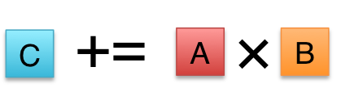

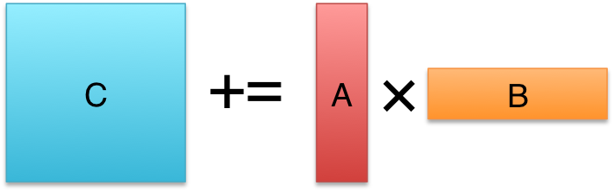

To achieve practical high performance
of Strassen’s algorithm…...
Conventional Implementations
Our Implementations
Matrix Size
Must be large
Matrix Shape
Must be square
Memory movement
No Additional
Workspace
Padding
Buffers
Parallelism
Usually task parallelism
Can be data parallelism
Notes:
In contrast, to achieve practical high performance of Strassen’s algorithm, our implementations…
1. Outperform standard matrix multiplication even for small square matrices
2. Achieve high performance for rank-k updates, a special case of matrix multiplication when m, n are much larger than k. This is actually widely used in applications.
3. don’t need additional workspace.
4. Easy to parallelize (data parallelism)
How do we achieve that? Let’s come to our outline.

Slide 12
Outline
Standard Matrix-matrix multiplication
Strassen’s Algorithm Reloaded
High-performance Implementations
Theoretical Model and Analysis
Performance Experiments
Conclusion
Notes:
1. we will dig into the implementations of standard matrix-matrix multiplication
2. we will present how we decompose Strassen’s algorithm into a combination of general operations,
3. which can be adapted to a high performance implementation in the third part.
4. Then, we give a performance model for comparing a family of Strassen implementations.
5. Finally, we give the performance evaluations and our conclusion.

Slide 13
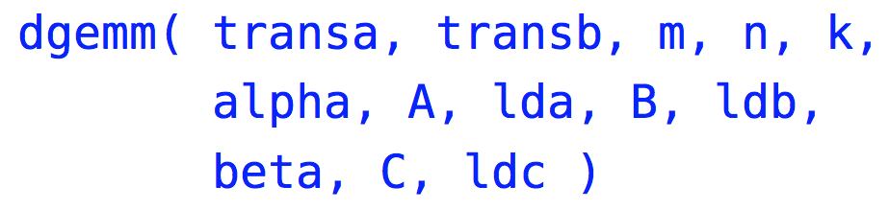
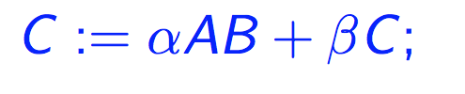

Level-3 BLAS matrix-matrix multiplication (GEMM)
(General) matrix-matrix multiplication (GEMM) is supported in the level-3 BLAS* interface as
Ignoring transa and transb, GEMM computes
We consider the simplified version of GEMM
*Dongarra, Jack J., et al. "A set of level 3 basic linear algebra subprograms."ACM Transactions on Mathematical Software (TOMS) 16.1 (1990): 1-17.
Notes:
Standard matrix multiplication is also called general matrix-matrix multiplication, or GEMM, supported by level-3 BLAS interface.
Here BLAS stands for Basic Linear Algebra Subprograms, which is the standard interface for dense linear algebra libraries.
The function call footprint is here. The “d” in dgemm here means “double precision”. In my talk, I will only consider the double precision case.
(click)
Ignoring transa and transb parameters, GEMM computes the formula…
A,B,C are matrices, alpha, beta are scalars.
(click)
In this talk, we can assume beta =1, since C can always first be multiplied by beta as a preprocessing step, which requires only O(n^2) flops.

Slide 14
State-of-the-art GEMM in BLIS
BLAS-like Library Instantiation Software (BLIS) is a portable framework for instantiating BLAS-like dense linear algebra libraries.
BLIS provides a refactoring of GotoBLAS algorithm (best-known approach) to implement GEMM.
GEMM implementation in BLIS has 6-layers of loops. The outer 5 loops are written in C. The inner-most loop (micro-kernel) is written in assembly for high performance.
Partition matrices into smaller blocks to fit into the different memory hierarchy.
The order of these loops is designed to utilize the cache reuse rate.
BLIS opens the black box of GEMM, leading to many applications built on BLIS.
Field Van Zee, and Robert van de Geijn. “BLIS: A Framework for Rapidly Instantiating BLAS Functionality." ACM TOMS 41.3 (2015): 14.
Kazushige Goto, and Robert van de Geijn. "High-performance implementation of the level-3 BLAS." ACM TOMS 35.1 (2008): 4.
Kazushige Goto, and Robert van de Geijn. "Anatomy of high-performance matrix multiplication." ACM TOMS 34.3 (2008): 12.
Chenhan D. Yu, *Jianyu Huang, Woody Austin, Bo Xiao, and George Biros. "Performance optimization for the k-nearest neighbors kernel on x86 architectures." In SC’15, p. 7. ACM, 2015.
*Jianyu Huang, Tyler Smith, Greg Henry, and Robert van de Geijn. “Strassen’s Algorithm Reloaded.” In submission to SC’16.
Devin Matthews, Field Van Zee, and Robert van de Geijn. “High-Performance Tensor Contraction without BLAS.” In submission to SC’16
Notes:
We use BLIS framework to illustrate the high-performance implementations of standard matrix multiplication: GEMM.
BLIS stands for BLAS-like Library Instantiation Software. It is a portable framework for instantiating BLAS-like dense linear algebra libraries.
(click)
BLIS provides a refactoring of GotoBLAS algorithm to implement GEMM, which is the best-known approach for CPU.
(click)
GEMM implementation in BLIS has 6-layers of loops. The outer 5 loops are written in C. The inner-most loop, or micro-kernel, is written in assembly for high performance.
The general idea is that BLIS partitions matrices into smaller blocks to fit into the different memory hierarchy, and the order of these loops is designed to utilize the cache reuse rate.

Slide 15
State-of-the-art GEMM in BLIS
BLAS-like Library Instantiation Software (BLIS) is a portable framework for instantiating BLAS-like dense linear algebra libraries.
BLIS provides a refactoring of GotoBLAS algorithm (best-known approach) to implement GEMM.
GEMM implementation in BLIS has 6-layers of loops. The outer 5 loops are written in C. The inner-most loop (micro-kernel) is written in assembly for high performance.
Partition matrices into smaller blocks to fit into the different memory hierarchy.
The order of these loops is designed to utilize the cache reuse rate.
BLIS opens the black box of GEMM, leading to many applications built on BLIS.
Field Van Zee, and Robert van de Geijn. “BLIS: A Framework for Rapidly Instantiating BLAS Functionality." ACM TOMS 41.3 (2015): 14.
Kazushige Goto, and Robert van de Geijn. "High-performance implementation of the level-3 BLAS." ACM TOMS 35.1 (2008): 4.
Kazushige Goto, and Robert van de Geijn. "Anatomy of high-performance matrix multiplication." ACM TOMS 34.3 (2008): 12.
Chenhan D. Yu, *Jianyu Huang, Woody Austin, Bo Xiao, and George Biros. "Performance optimization for the k-nearest neighbors kernel on x86 architectures." In SC’15, p. 7. ACM, 2015.
*Jianyu Huang, Tyler Smith, Greg Henry, and Robert van de Geijn. “Strassen’s Algorithm Reloaded.” To appear in SC’16.
Devin Matthews, Field Van Zee, and Robert van de Geijn. “High-Performance Tensor Contraction without BLAS.” In submission to SC’16
Notes:
BLIS opens the black box of GEMM, which leads to many applications built on BLIS.
For those applications with heavy use of GEMM, BLIS makes it possible to modifying GEMM itself (e.g. by fusing the code), which is very difficult before.
In the SC’15, we have a publication about fusing the DGEMM with sorting operations for k-nearest neighbor problems.
In the SC’16, we just submit a conference paper about a family of high-performance Strassen implementations based on BLIS framework, which is about the Strassen topic I am presenting in this lecture.
//Originally difficult, now it is easy.

Slide 16
Memory Hierarchy
Ivy Bridge
Xeon Phi
Register
AVX256
AVX512
Smaller,
Faster
32 KB
32 KB
L1 cache
256 KB
512 KB
L2 cache
L3 cache
25.6 MB
----
Main memory
128 GB
8 GB
Notes:
Before we dig into the details of the GEMM implementation in BLIS, we need to look into the background knowledge of memory hierarchy.
(click)
This pyramid graph shows the simplified model for memory hierarchy. The modern CPU architecture has Register, 3 layers of cache, and memory.
(click)
The Higher the memory is -> The smaller, faster, more expensive it is.
(click)
Here is the corresponding size parameters for Ivy Bridge and Xeon Phi, Intel multi-core and many-core architectures.
AVX256 -> 256bits

Slide 17
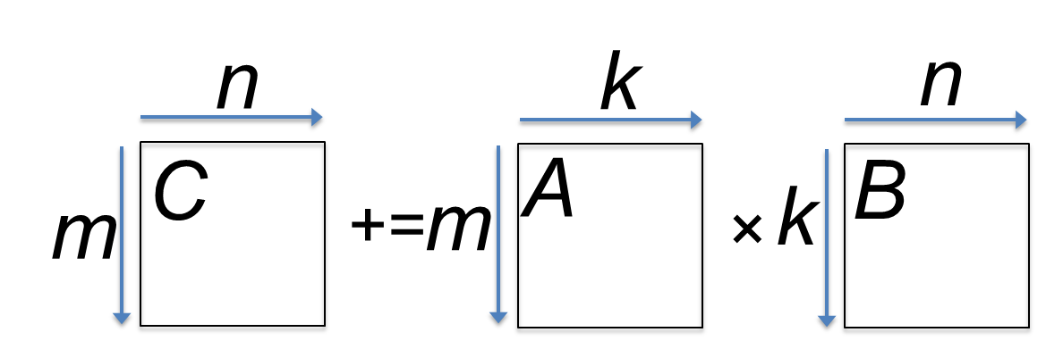
GotoBLAS algorithm for GEMM in BLIS
*Field G. Van Zee, and Tyler M. Smith. “Implementing high-performance complex matrix multiplication." In ACM Transactions on Mathematical Software (TOMS), accepted pending modifications.
Notes:
Now let’s dig into the GotoBLAS algorithm for GEMM in BLIS.
//Memory packing buffer -> Strassen workspace

Slide 18
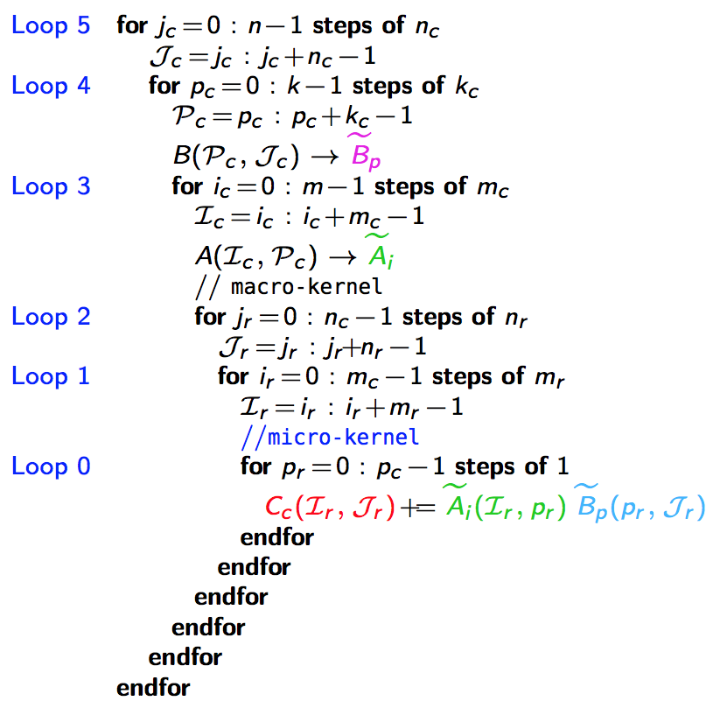
n_{C}
5th loop around micro-kernel
n_{C}
GotoBLAS algorithm for GEMM in BLIS
C_{j}
A
B_{j}
n_{C}
+=
n_{C}
main memory
*Field G. Van Zee, and Tyler M. Smith. “Implementing high-performance complex matrix multiplication." In ACM Transactions on Mathematical Software (TOMS), accepted pending modifications.
Notes:
The algorithm contains 6 layers of loops,
We index them from Loop 5 to Loop 0, from outside to inside.
each loop is corresponding to different partitioning of the m, n, and k dimensions.
In the outer most loop, or Loop 5, C and B are partitioned with block size nC, in the n dimension.

Slide 19
n_{C}
5th loop around micro-kernel
n_{C}
GotoBLAS algorithm for GEMM in BLIS
C_{j}
A
B_{j}
n_{C}
+=
n_{C}
4th loop around micro-kernel
C_{j}
A_{p}
k_{C}
B_{p}
+=
k_{C}
~
Pack B_{p} → B_{p}
~
B_{p}
main memory
L3 cache
*Field G. Van Zee, and Tyler M. Smith. “Implementing high-performance complex matrix multiplication." In ACM Transactions on Mathematical Software (TOMS), accepted pending modifications.
Notes:
In the second outermost loop, or Loop 4 here, both A and B are partitioned along the k dimension, with the block size of kC;
Note that the purple box inside this loop, we need to duplicate and rearrange the panel Bp into the contiguous memory buffer ~Bp~.
This Process ->is called memory packing.
The buffer ~Bp~ is designed to fit into L3 cache.

Slide 20
n_{C}
5th loop around micro-kernel
n_{C}
GotoBLAS algorithm for GEMM in BLIS
C_{j}
A
B_{j}
n_{C}
+=
n_{C}
4th loop around micro-kernel
C_{j}
A_{p}
k_{C}
B_{p}
+=
k_{C}
~
3rd loop around micro-kernel
Pack B_{p} → B_{p}
C_{i}
m_{C}
A_{i}
~
m_{C}
B_{p}
+=
~
Pack A_{i}→ A_{i}
~
A_{i}
m_{R}
k_{C}
main memory
L3 cache
L2 cache
*Field G. Van Zee, and Tyler M. Smith. “Implementing high-performance complex matrix multiplication." In ACM Transactions on Mathematical Software (TOMS), accepted pending modifications.
Notes:
Loop 3 further partitions the m dimension of A and C with block size mC;
Note the green box.
Inside Loop 3, the panel Ai is also packed into a contiguous buffer ~Ai~ to fit in the L2 cache.
Note that Strassen also requires the workspace buffer. Can we just utilize this packing buffer for Strassen workspace buffer? We will talk about this in the later slides.
But the important point here is that the high-performance implementation GEMM requires packing buffers anyway.

Slide 21
n_{C}
5th loop around micro-kernel
n_{C}
GotoBLAS algorithm for GEMM in BLIS
C_{j}
A
B_{j}
n_{C}
+=
n_{C}
4th loop around micro-kernel
C_{j}
A_{p}
k_{C}
B_{p}
+=
k_{C}
~
3rd loop around micro-kernel
Pack B_{p} → B_{p}
C_{i}
m_{C}
A_{i}
~
m_{C}
B_{p}
+=
~
Pack A_{i}→ A_{i}
n_{R}
2nd loop around micro-kernel
~
n_{R}
~
A_{i}
B_{p}
C_{i}
m_{R}
+=
k_{C}
main memory
L3 cache
L2 cache
*Field G. Van Zee, and Tyler M. Smith. “Implementing high-performance complex matrix multiplication." In ACM Transactions on Mathematical Software (TOMS), accepted pending modifications.
Notes:
Inside Loop3 is what we call macro-kernel, or inner-kernel in the original GotoBLAS algorithm.
BLIS refactors GotoBLAS algorithm and exposes two more loops: Loop 2 and Loop 1.
Loop 2 partitions the n dimension with the block size of nR.

Slide 22
n_{C}
5th loop around micro-kernel
n_{C}
GotoBLAS algorithm for GEMM in BLIS
C_{j}
A
B_{j}
n_{C}
+=
n_{C}
4th loop around micro-kernel
C_{j}
A_{p}
k_{C}
B_{p}
+=
k_{C}
~
3rd loop around micro-kernel
Pack B_{p} → B_{p}
C_{i}
m_{C}
A_{i}
~
m_{C}
B_{p}
+=
~
Pack A_{i}→ A_{i}
n_{R}
2nd loop around micro-kernel
~
n_{R}
~
A_{i}
B_{p}
C_{i}
m_{R}
+=
k_{C}
1st loop around micro-kernel
n_{R}
m_{R}
+=
Update C_{ij}
k_{C}
main memory
L3 cache
L2 cache
L1 cache
*Field G. Van Zee, and Tyler M. Smith. “Implementing high-performance complex matrix multiplication." In ACM Transactions on Mathematical Software (TOMS), accepted pending modifications.
registers
Notes:
Loop 1 partitions the m dimension with the block size of mR.
As a result, the BLIS framework exposes 5 loops that can be parallelized, 2 more loops comparing to the original GotoBLAS algorithm.
Note the blue box here.
at this stage, the micro panel of ~Bp~ is lifted into L1 cache.

Slide 23
n_{C}
5th loop around micro-kernel
n_{C}
GotoBLAS algorithm for GEMM in BLIS
C_{j}
A
B_{j}
n_{C}
+=
n_{C}
4th loop around micro-kernel
C_{j}
A_{p}
k_{C}
B_{p}
+=
k_{C}
~
3rd loop around micro-kernel
Pack B_{p} → B_{p}
C_{i}
m_{C}
A_{i}
~
m_{C}
B_{p}
+=
~
Pack A_{i}→ A_{i}
n_{R}
2nd loop around micro-kernel
~
n_{R}
~
A_{i}
B_{p}
C_{i}
m_{R}
+=
k_{C}
1st loop around micro-kernel
n_{R}
m_{R}
+=
Update C_{ij}
k_{C}
micro-kernel
main memory
1
L3 cache
+=
L2 cache
1
L1 cache
*Field G. Van Zee, and Tyler M. Smith. “Implementing high-performance complex matrix multiplication." In ACM Transactions on Mathematical Software (TOMS), accepted pending modifications.
registers
Notes:
Finally, the micro-kernel contains Loop 0, the inner most loop.
The micro-kernel computes the outer product of a micro-panel in packing buffer A,
and a micro-panel in packing buffer B
as a sequence of kC rank 1 updates,
Accumulating the result of micro-tile of C,
which is a mR x nR size, residing in registers.
//m_R x n_R micro tile is updated inside the registers.

Slide 24
n_{C}
5th loop around micro-kernel
n_{C}
GotoBLAS algorithm for GEMM in BLIS
C_{j}
A
B_{j}
n_{C}
+=
n_{C}
4th loop around micro-kernel
C_{j}
A_{p}
k_{C}
B_{p}
+=
k_{C}
~
3rd loop around micro-kernel
Pack B_{p} → B_{p}
C_{i}
m_{C}
A_{i}
~
m_{C}
B_{p}
+=
~
Pack A_{i}→ A_{i}
n_{R}
2nd loop around micro-kernel
~
n_{R}
~
A_{i}
B_{p}
C_{i}
m_{R}
+=
k_{C}
1st loop around micro-kernel
n_{R}
m_{R}
+=
Update C_{ij}
k_{C}
micro-kernel
main memory
1
L3 cache
+=
L2 cache
1
L1 cache
*Field G. Van Zee, and Tyler M. Smith. “Implementing high-performance complex matrix multiplication." In ACM Transactions on Mathematical Software (TOMS), accepted pending modifications.
registers
Notes:
Note that
before the accumulation, C is preloaded into the register from the memory.
After the accumulation is finished, C is updated to memory from the register.

Slide 25
Outline
Conventional Matrix-matrix multiplication
Strassen’s Algorithm Reloaded
High-performance Implementations
Theoretical Model and Analysis
Performance Experiments
Conclusion
Notes:
Now let’s walk through how we reload the Strassen’s algorithm for a high-performance implementation

Slide 26
One-level Strassen’s Algorithm Reloaded
M₀ := α(A₀₀+A₁₁)(B₀₀+B₁₁);
M₁ := α(A₁₀+A₁₁)B₀₀;
M₂ := αA₀₀(B₀₁–B₁₁);
M₃ := αA₁₁(B₁₀–B₀₀);
M₄ := α(A₀₀+A₀₁)B₁₁;
M₅ := α(A₁₀–A₀₀)(B₀₀+B₀₁);
M₆ := α(A₀₁–A₁₁)(B₁₀+B₁₁);
C₀₀ += M₀ + M₃ – M₄ + M₆
C₀₁ += M₂ + M₄
C₁₀ += M₁ + M₃
C₁₁ += M₀ – M₁ + M₂ + M₅
M₀ := α(A₀₀+A₁₁)(B₀₀+B₁₁); C₀₀ += M₀; C₁₁ += M₀;
M₁ := α(A₁₀+A₁₁)B₀₀; C₁₀ += M₁; C₁₁ –= M₁;
M₂ := αA₀₀(B₀₁–B₁₁); C₀₁ += M₂; C₁₁ += M₂;
M₃ := αA₁₁(B₁₀–B₀₀); C₀₀ += M₃; C₁₀ += M₃;
M₄ := α(A₀₀+A₀₁)B₁₁; C₀₁ += M₄; C₀₀ –= M₄;
M₅ := α(A₁₀–A₀₀)(B₀₀+B₀₁); C₁₁ += M₅;
M₆ := α(A₀₁–A₁₁)(B₁₀+B₁₁); C₀₀ += M₆;
M := α(X+Y)(V+W); C +=M; D +=M;
General operation for one-level Strassen:
M := α(X+δY)(V+εW); C += γ₀M; D += γ₁M;
γ₀, γ₁,δ,ε ∈ {-1, 0, 1}.
Notes:
(click)
We rearrange the instructions into 7 rows of operations.
The transformation is just a reordering, for example, we will update C00 and C11 immediately after we get M0.
The amount of matrix multiplication and matrix addition is not changed with this reordering.
(click)
For the first row, if we replace some symbols, we get this form.
(click)
If we walk through each row and add the coefficient, we get a general operation.
each row is a special case of the general operation of this form.
the coefficients belong to the set: -1, 0, or 1.

Slide 27


High-performance implementation of the general operation?
M := α(X+δY)(V+εW); C += γ₀M; D += γ₁M;
γ₀, γ₁,δ,ε ∈ {-1, 0, 1}.
*http://shpc.ices.utexas.edu/index.html
Notes:
So the problem is reduced to provide the high performance implementation of the general operation.
(click)
We are from the science of high-performance computing group. We want to give a high-performance implementation of the general operation.

Slide 28
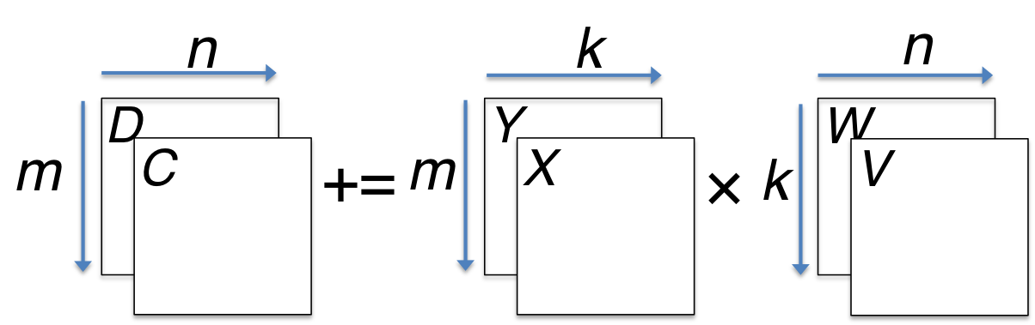
M := α(X+δY)(V+εW); C += γ₀M; D += γ₁M;
γ₀, γ₁,δ,ε ∈ {-1, 0, 1}.
*Jianyu Huang, Tyler Smith, Greg Henry, and Robert van de Geijn. “Strassen’s Algorithm Reloaded.” In submission to SC’16.
Notes:
This is the general operation.

Slide 29
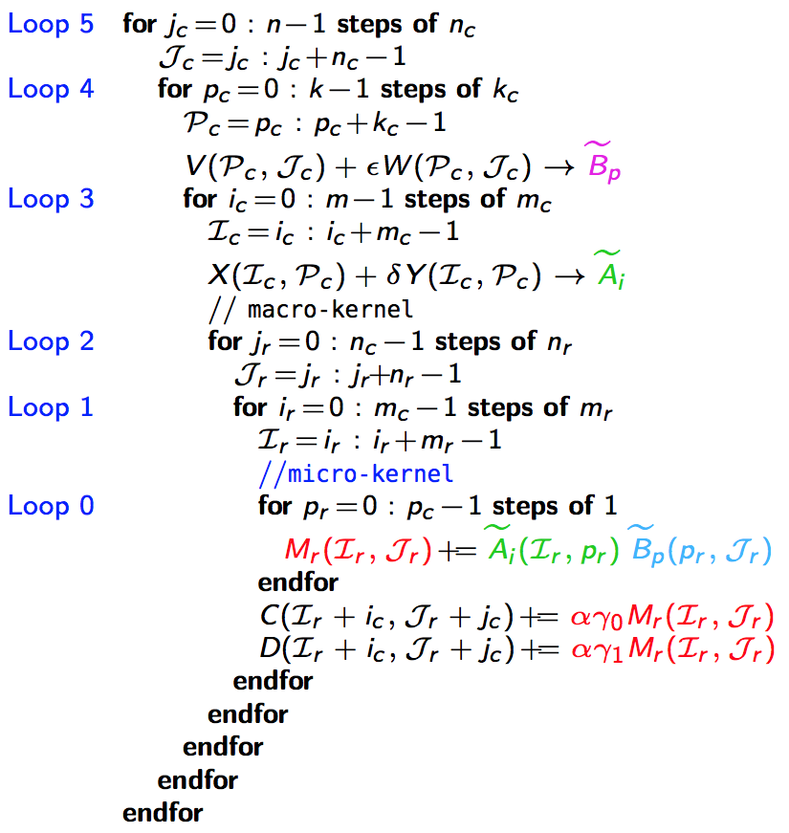
M := α(X+δY)(V+εW); C += γ₀M; D += γ₁M;
γ₀, γ₁,δ,ε ∈ {-1, 0, 1}.
5th loop around micro-kernel
n_{C}
n_{C}
D_{j}
Y
W
n_{C}
n_{C}
C_{j}
+=
X
V_{j}
main memory
*Jianyu Huang, Tyler Smith, Greg Henry, and Robert van de Geijn. “Strassen’s Algorithm Reloaded.” In submission to SC’16.
Notes:
We just use the same Loop structure as GotoBLAS algorithm in GEMM.
In the outer most loop, or Loop 5, C,D and V,W are partitioned with block size nC, in the n dimension.

Slide 30
M := α(X+δY)(V+εW); C += γ₀M; D += γ₁M;
γ₀, γ₁,δ,ε ∈ {-1, 0, 1}.
5th loop around micro-kernel
n_{C}
n_{C}
D_{j}
Y
W
n_{C}
n_{C}
C_{j}
+=
X
V_{j}
4th loop around micro-kernel
D_{j}
Y_{p}
k_{C}
W_{p}
C_{j}
+=
X_{p}
V_{p}
k_{C}
~
Pack V_{p} + εW_{p} → B_{p}
~
B_{p}
main memory
L3 cache
*Jianyu Huang, Tyler Smith, Greg Henry, and Robert van de Geijn. “Strassen’s Algorithm Reloaded.” In submission to SC’16.
Notes:
In the second outermost loop, or Loop 4 here, both X,Y and V,W are partitioned in the k dimension, with the block size of kC;
Here is tricky part: we finish V+\epsilon W during the packing process.
Given the fact that GEMM always has the packing buffer,
we can utilize that buffer as the workspace,
so we don’t need to allocate extra workspace buffer for Strassen.
We also guarantee that the packing buffer ~Bp~ reside in L3 cache, thus it will reduce the slow memory operations.

Slide 31
M := α(X+δY)(V+εW); C += γ₀M; D += γ₁M;
γ₀, γ₁,δ,ε ∈ {-1, 0, 1}.
5th loop around micro-kernel
n_{C}
n_{C}
D_{j}
Y
W
n_{C}
n_{C}
C_{j}
+=
X
V_{j}
4th loop around micro-kernel
D_{j}
Y_{p}
k_{C}
W_{p}
C_{j}
+=
X_{p}
V_{p}
k_{C}
~
3rd loop around micro-kernel
Pack V_{p} + εW_{p} → B_{p}
D_{i}
m_{C}
Y_{i}
~
C_{i}
X_{i}
B_{p}
m_{C}
+=
~
Pack X_{i} + δY_{i}→ A_{i}
~
A_{i}
m_{R}
k_{C}
main memory
L3 cache
L2 cache
*Jianyu Huang, Tyler Smith, Greg Henry, and Robert van de Geijn. “Strassen’s Algorithm Reloaded.” In submission to SC’16.
Notes:
Loop 3 further partitions the m dimension of X,Y and C, D with block size mC;
While we do packing, we also finishes X+\delta Y.
The result will stay in L2 cache.

Slide 32
M := α(X+δY)(V+εW); C += γ₀M; D += γ₁M;
γ₀, γ₁,δ,ε ∈ {-1, 0, 1}.
5th loop around micro-kernel
n_{C}
n_{C}
D_{j}
Y
W
n_{C}
n_{C}
C_{j}
+=
X
V_{j}
4th loop around micro-kernel
D_{j}
Y_{p}
k_{C}
W_{p}
C_{j}
+=
X_{p}
V_{p}
k_{C}
~
3rd loop around micro-kernel
Pack V_{p} + εW_{p} → B_{p}
D_{i}
m_{C}
Y_{i}
~
C_{i}
X_{i}
B_{p}
m_{C}
+=
~
Pack X_{i} + δY_{i}→ A_{i}
n_{R}
2nd loop around micro-kernel
~
n_{R}
~
A_{i}
B_{p}
D_{i}
m_{R}
+=
C_{i}
k_{C}
main memory
L3 cache
L2 cache
*Jianyu Huang, Tyler Smith, Greg Henry, and Robert van de Geijn. “Strassen’s Algorithm Reloaded.” In submission to SC’16.
Notes:
Loop 2 and Loop 1 are exactly the same as GotoBLAS algorithm.

Slide 33
M := α(X+δY)(V+εW); C += γ₀M; D += γ₁M;
γ₀, γ₁,δ,ε ∈ {-1, 0, 1}.
5th loop around micro-kernel
n_{C}
n_{C}
D_{j}
Y
W
n_{C}
n_{C}
C_{j}
+=
X
V_{j}
4th loop around micro-kernel
D_{j}
Y_{p}
k_{C}
W_{p}
C_{j}
+=
X_{p}
V_{p}
k_{C}
~
3rd loop around micro-kernel
Pack V_{p} + εW_{p} → B_{p}
D_{i}
m_{C}
Y_{i}
~
C_{i}
X_{i}
B_{p}
m_{C}
+=
~
Pack X_{i} + δY_{i}→ A_{i}
n_{R}
2nd loop around micro-kernel
~
n_{R}
~
A_{i}
B_{p}
D_{i}
m_{R}
+=
C_{i}
k_{C}
n_{R}
1st loop around micro-kernel
m_{R}
+=
Update C_{ij} , D_{ij}
k_{C}
main memory
L3 cache
L2 cache
L1 cache
*Jianyu Huang, Tyler Smith, Greg Henry, and Robert van de Geijn. “Strassen’s Algorithm Reloaded.” In submission to SC’16.
registers
Notes:
(Ignoring)
Loop 2 and Loop 1 are exactly the same as GotoBLAS algorithm.

Slide 34
M := α(X+δY)(V+εW); C += γ₀M; D += γ₁M;
γ₀, γ₁,δ,ε ∈ {-1, 0, 1}.
5th loop around micro-kernel
n_{C}
n_{C}
D_{j}
Y
W
n_{C}
n_{C}
C_{j}
+=
X
V_{j}
4th loop around micro-kernel
D_{j}
Y_{p}
k_{C}
W_{p}
C_{j}
+=
X_{p}
V_{p}
k_{C}
~
3rd loop around micro-kernel
Pack V_{p} + εW_{p} → B_{p}
D_{i}
m_{C}
Y_{i}
~
C_{i}
X_{i}
B_{p}
m_{C}
+=
~
Pack X_{i} + δY_{i}→ A_{i}
n_{R}
2nd loop around micro-kernel
~
n_{R}
~
A_{i}
B_{p}
D_{i}
m_{R}
+=
C_{i}
k_{C}
n_{R}
1st loop around micro-kernel
m_{R}
+=
Update C_{ij} , D_{ij}
k_{C}
micro-kernel
main memory
1
L3 cache
+=
L2 cache
1
L1 cache
*Jianyu Huang, Tyler Smith, Greg Henry, and Robert van de Geijn. “Strassen’s Algorithm Reloaded.” In submission to SC’16.
registers
Notes:
Inside the micro-kernel,
The accumulation step is also exactly the same as the GOTOBLAS algorithm.

Slide 35
M := α(X+δY)(V+εW); C += γ₀M; D += γ₁M;
γ₀, γ₁,δ,ε ∈ {-1, 0, 1}.
5th loop around micro-kernel
n_{C}
n_{C}
D_{j}
Y
W
n_{C}
n_{C}
C_{j}
+=
X
V_{j}
4th loop around micro-kernel
D_{j}
Y_{p}
k_{C}
W_{p}
C_{j}
+=
X_{p}
V_{p}
k_{C}
~
3rd loop around micro-kernel
Pack V_{p} + εW_{p} → B_{p}
D_{i}
m_{C}
Y_{i}
~
C_{i}
X_{i}
B_{p}
m_{C}
+=
~
Pack X_{i} + δY_{i}→ A_{i}
n_{R}
2nd loop around micro-kernel
~
n_{R}
~
A_{i}
B_{p}
D_{i}
m_{R}
+=
C_{i}
k_{C}
n_{R}
1st loop around micro-kernel
m_{R}
+=
Update C_{ij} , D_{ij}
k_{C}
micro-kernel
main memory
1
L3 cache
+=
L2 cache
1
L1 cache
*Jianyu Huang, Tyler Smith, Greg Henry, and Robert van de Geijn. “Strassen’s Algorithm Reloaded.” In submission to SC’16.
registers
Notes:
The difference is that
before the accumulation, C and D are preloaded into the register from the memory.
After the accumulation is finished, C and D are updated to memory from the register.
We don’t need to allocate extra memory buffer for storing the intermediate matrix product Mi, since M has the size mr x nr, staying in the register.

Slide 36
n_{C}
5th loop around micro-kernel
n_{C}
n_{C}
5th loop around micro-kernel
n_{C}
C_{j}
A
B
D_{j}
Y
W
n_{C}
n_{C}
n_{C}
n_{C}
+=
C_{j}
+=
X
V_{j}
4th loop around micro-kernel
4th loop around micro-kernel
C_{j}
A_{p}
k_{C}
B_{p}
D_{j}
Y_{p}
k_{C}
W_{p}
+=
C_{j}
+=
X_{p}
V_{p}
k_{C}
k_{C}
~
~
3rd loop around micro-kernel
Pack B_{p} → B_{p}
3rd loop around micro-kernel
Pack V_{p} + εW_{p} → B_{p}
C_{i}
A_{i}
~
D_{i}
m_{C}
Y_{i}
~
m_{C}
m_{C}
B_{p}
C_{i}
X_{i}
B_{p}
m_{C}
+=
+=
~
~
Pack A_{i}→ A_{i}
Pack X_{i} + δY_{i}→ A_{i}
n_{R}
2nd loop around micro-kernel
~
n_{R}
~
n_{R}
2nd loop around micro-kernel
~
n_{R}
~
A_{i}
B_{p}
A_{i}
B_{p}
C_{i}
m_{R}
D_{i}
m_{R}
+=
+=
k_{C}
C_{i}
k_{C}
n_{R}
1st loop around micro-kernel
n_{R}
1st loop around micro-kernel
m_{R}
+=
m_{R}
+=
Update C_{ij}
k_{C}
Update C_{ij} , D_{ij}
k_{C}
micro-kernel
micro-kernel
main memory
1
main memory
1
L3 cache
+=
L3 cache
+=
L2 cache
1
L2 cache
1
L1 cache
L1 cache
registers
registers
Notes:
Here is the comparison graph between the original GOTOBLAS DGEMM and our adapted general operation implementations.
Basically we changed 3 parts:
pack A
pack B
update C in the micro-kernel.

Slide 37
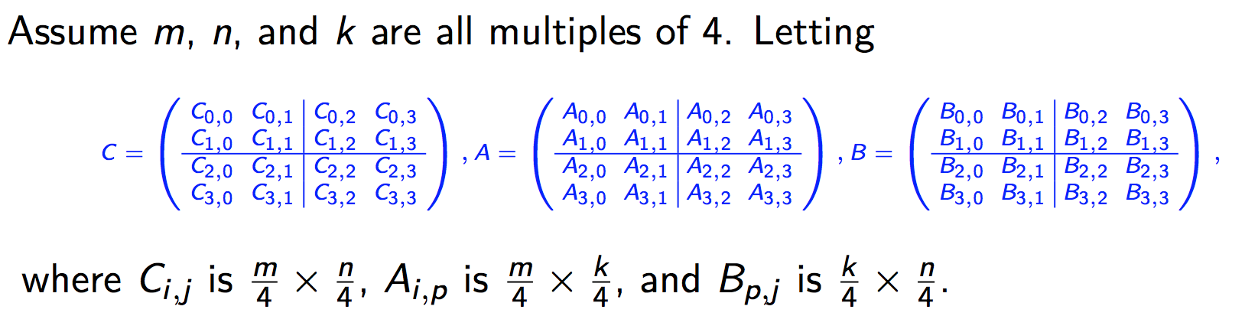
Two-level Strassen’s Algorithm Reloaded
Notes:
So that is just for 1-level Strassen.
(click)
Now let’s reload the two-level Strassen’s algorithm
Assume the matrix size m, n, and k are all multiples of 4.
We can split the matrices into 4x4 submatrices and implement 2-level Strassen’s algorithm

Slide 38
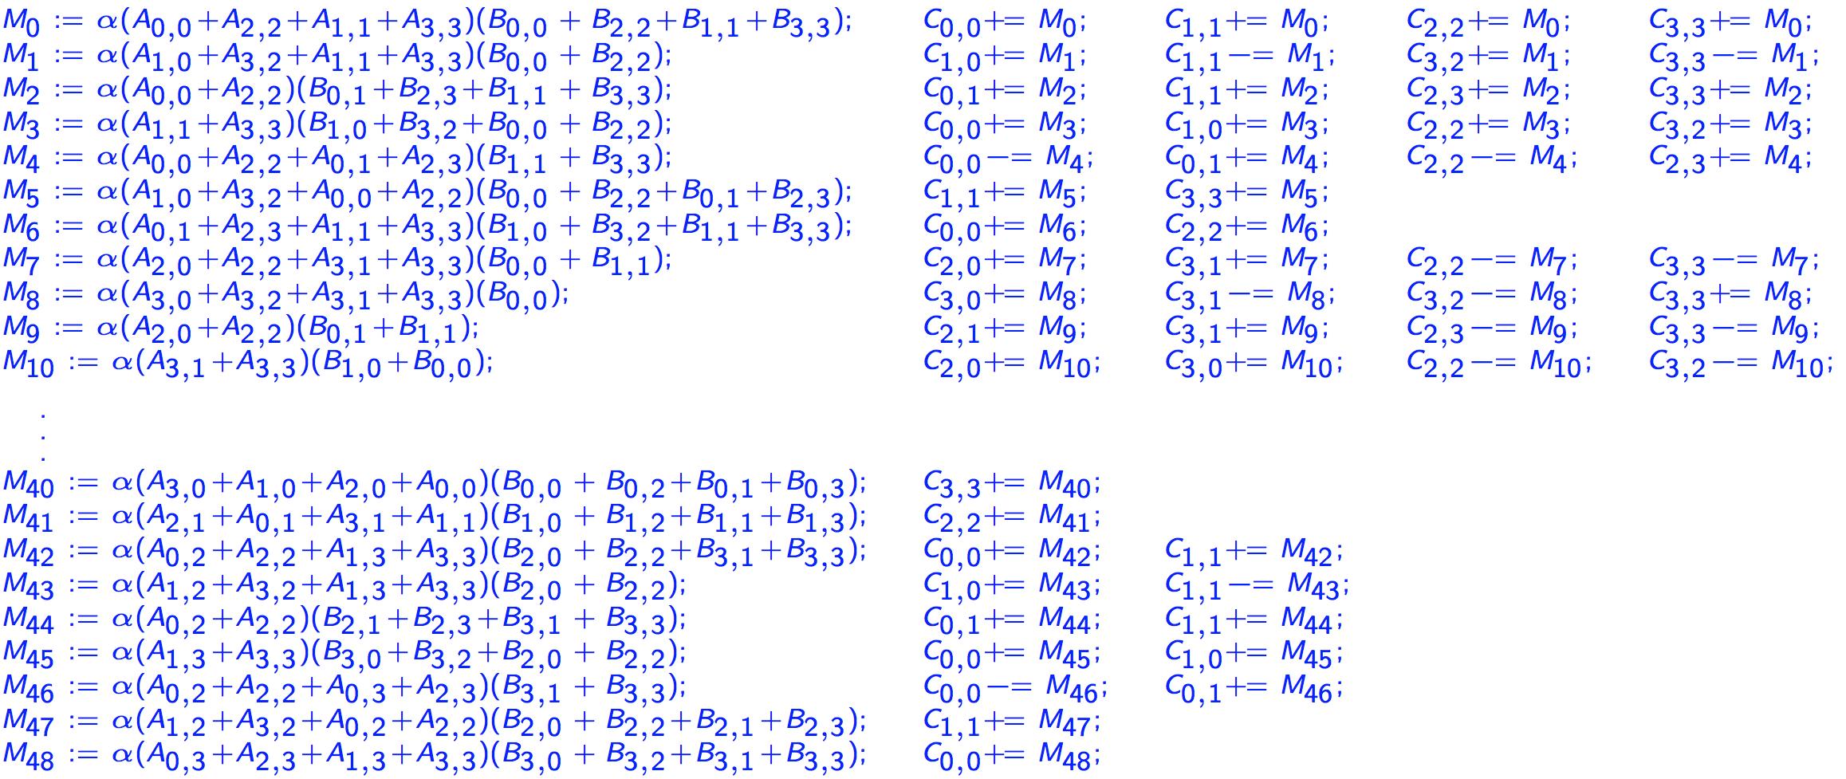
Two-level Strassen’s Algorithm Reloaded (Continue)
M := α(X₀+X₁+X₂+X₃)(V+V₁+V₂+V₃); C₀ += M; C₁ += M; C₂ += M; C₃ += M;
General operation for two-level Strassen:
M := α(X₀+δ₁X₁+δ₂X₂+δ₃X₃)(V+ε₁V₁+ε₂V₂+ε₃V₃); C₀ += γ₀M; C₁ += γ₁M; C₂ += γ₂M; C₃ += γ₃M;
γ_{i},δ_{i},ε_{i} ∈ {-1, 0, 1}.
Notes:
Here are the 49 instructions to implement 2-level Strassen.
Similar to 1-level Strassen, we update C immediately after we get M.
(click)
For the first row, if we replace some symbols, we get this form.
(click)
If we walk through each row and add the coefficients, we get a general operation.
each row is a special case of the general operation of this form.
Again, the coefficients belong to the set: -1, 0, or 1.

Slide 39
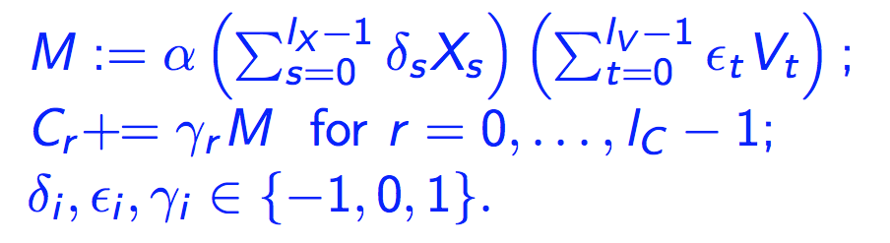
Additional Levels of Strassen Reloaded
The general operation of one-level Strassen:
The general operation of two-level Strassen:
The general operation needed to integrate k levels of Strassen is given by
M := α(X+δY)(V+εW); C += γ₀M; D += γ₁M;
γ₀, γ₁,δ,ε ∈ {-1, 0, 1}.
M := α(X₀+δ₁X₁+δ₂X₂+δ₃X₃)(V+ε₁V₁+ε₂V₂+ε₃V₃);
C₀ += γ₀M; C₁ += γ₁M; C₂ += γ₂M; C₃ += γ₃M;
γ_{i},δ_{i},ε_{i} ∈ {-1, 0, 1}.
Notes:
For additional levels of Strassen’s agorithm
(click)
We can generalize to such a form.
Each item has 2’s power parameters here.

Slide 40
Outline
Conventional Matrix-matrix multiplication
Strassen’s Algorithm Reloaded
High-performance Implementations
Theoretical Model and Analysis
Performance Experiments
Conclusion
Notes:
Now let’s discuss the details for our high performance implementations of a family of Strassen algorithms.

Slide 41


Building blocks
BLIS framework
Adapted to general operation
A routine for packing B_{p} into
C/Intel intrinsics
A routine for packing A_{i} into
C/Intel intrinsics
A micro-kernel for updating an m_{R}×n_{R} submatrix of C.
SIMD assembly (AVX, AVX512, etc)
Integrate the addition of multiple matrices V_{t} into
Integrate the addition of multiple matrices X_{s} into
Integrate the update of multiple submatrices of C.
Notes:
This is the general operation for any level Strassen.
BLIS framework provides three primitive operations for composing DGEMM:
(click)
Pack B: C
(click)
2. Pack A: C
(click)
3. Micro-kernel: assembly
We
(click)
Adapt Pack B by…
(click)
2. Adapt Pack A by…
(click)
3. Adapt Micro-kernel by…
To better understand the performance impact of each of these changes,
We implement three variations of Strassen as a family of Strassen implementations.

Slide 42
Variations on a theme
Naïve Strassen
A traditional implementation with temporary buffers.
AB Strassen
Integrate the addition of matrices into and .
ABC Strassen
Integrate the addition of matrices into and .
Integrate the update of multiple submatrices of C in the micro-kernel.
Notes:
(To better understand the performance impact of each of these changes, we implement three variations of Strassen as a family of Strassen implementations.)
Depending on which changes of primitive they incorporate, we have three implementations.
(click)
For Naïve Strassen
(click)
For AB Strassen
(click)
For ABC Strassen
These implementations form a family of Strassen implementations.

Slide 43
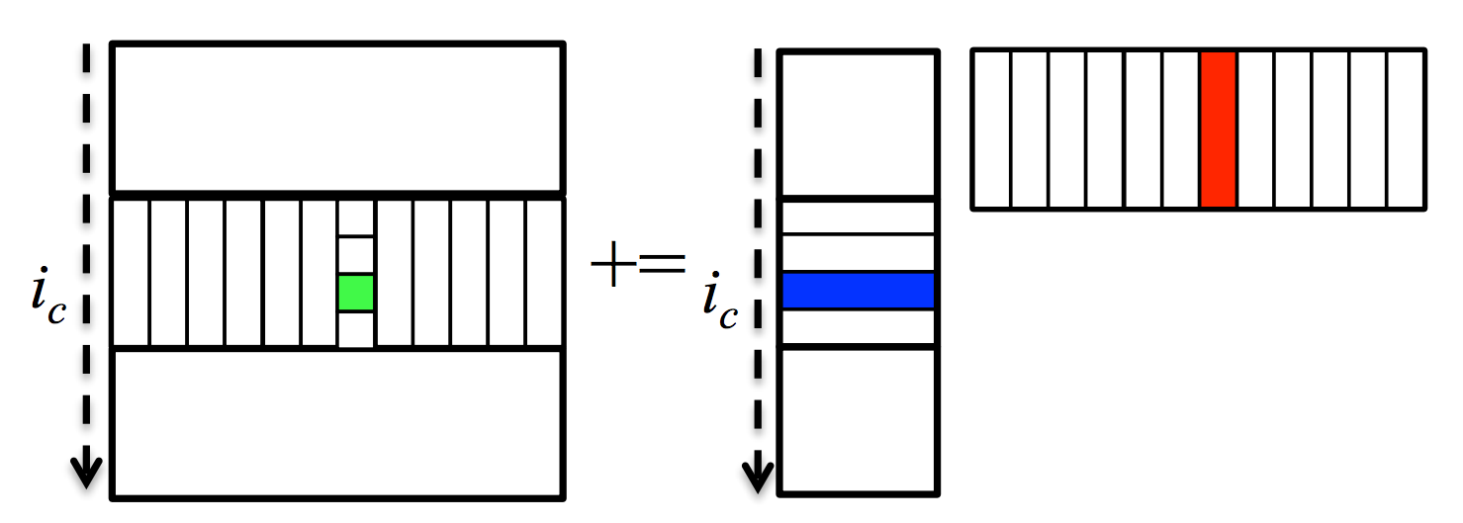
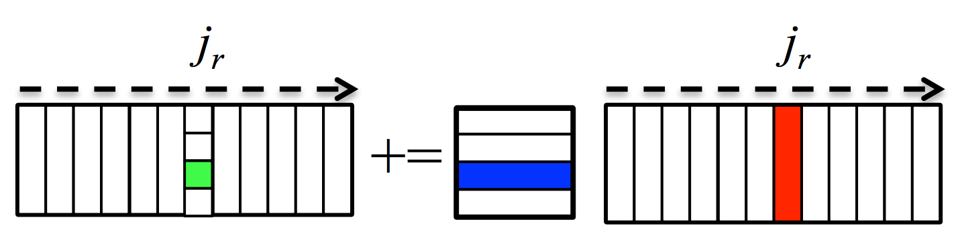
Parallelization
5th loop around micro-kernel
n_{C}
n_{C}
D_{j}
Y
W
n_{C}
n_{C}
C_{j}
+=
X
V_{j}
For architectures with independent L2 cache, we parallelize 3rd loop (along m_{C} direction)
For architectures with shared L2 cache, we parallelize 2nd loop (along n_{R} direction)
For many-core architecture (e.g. Xeon Phi, 240 threads), we parallelize both 3rd and 2nd loop
4th loop around micro-kernel
D_{j}
Y_{p}
k_{C}
W_{p}
C_{j}
+=
X_{p}
V_{p}
k_{C}
~
3rd loop around micro-kernel
Pack V_{p} + εW_{p} → B_{p}
D_{i}
m_{C}
Y_{i}
~
C_{i}
X_{i}
B_{p}
m_{C}
+=
~
Pack X_{i} + δY_{i}→ A_{i}
n_{R}
2nd loop around micro-kernel
~
n_{R}
~
A_{i}
B_{p}
D_{i}
m_{R}
+=
C_{i}
k_{C}
n_{R}
1st loop around micro-kernel
m_{R}
+=
Update C_{ij} , D_{ij}
k_{C}
micro-kernel
main memory
1
L3 cache
+=
*Tyler M. Smith, Robert Van De Geijn, Mikhail Smelyanskiy, Jeff R. Hammond, and Field G. Van Zee. "Anatomy of high-performance many-threaded matrix multiplication." In Parallel and Distributed Processing Symposium, 2014 IEEE 28th International, pp. 1049-1059. IEEE, 2014.
L2 cache
1
L1 cache
registers
Notes:
We adopt the same parallellization scheme with the GEMM implementations in BLIS.

Slide 44
Outline
Conventional Matrix-matrix multiplication
Strassen’s Algorithm Reloaded
High-performance Implementations
Theoretical Model and Analysis
Performance Experiments
Conclusion
Notes:
Now, we give a performance model for comparing the different implementations.
Theoretical model allows us to compare and contrast different implementation decisions,
help us with performance debugging.
And select the right implementations.

Slide 45
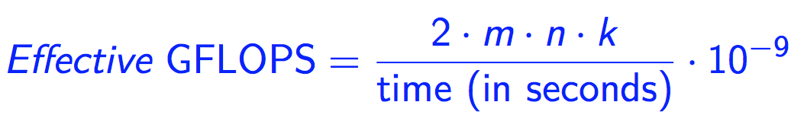
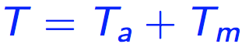
Performance Model
Performance Metric
Total Time Breakdown
Arithmetic
Operations
Memory
Operations
Notes:
First we define the performance metric:
The effective GFLOPS is ony true GFLOPS for GEMM.
Strassen performs fewer floating point operations.
However, this metric allows us to compare all of the algorithms in an inverse-time scale, normalized by the problem size.
Our performance model will help us predict
--the execution time T
--the effective GFLOPS of DGEMM and the different implementations of Strassen.
(click)
We break down the total time into two parts: the arithmetic operations and the memory operations.
Memory->packing time

Slide 46
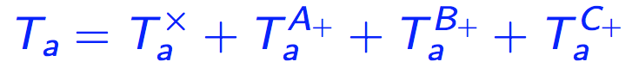

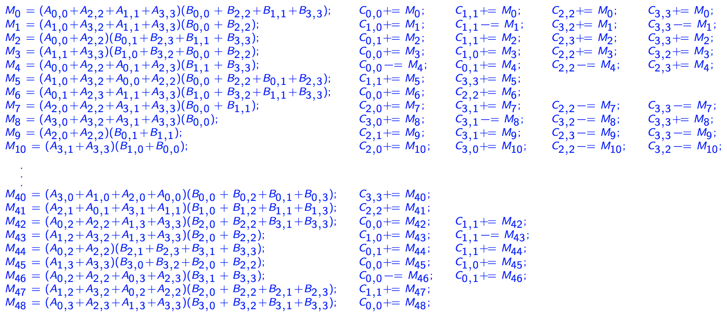
Arithmetic Operations
Submatrix
multiplication
Extra additions with submatrices of A, B, C, respectively
DGEMM
No extra additions
One-level Strassen (ABC, AB, Naïve)
7 submatrix multiplications
5 extra additions of submatrices of A and B
12 extra additions of submatrices of C
Two-level Strassen (ABC, AB, Naïve)
49 submatrix multiplications
95 extra additions of submatrices of A and B
154 extra additions of submatrices of C
unit time for one arithmetic operation
M₀ := α(A₀₀+A₁₁)(B₀₀+B₁₁); C₀₀ += M₀; C₁₁ += M₀;
M₁ := α(A₁₀+A₁₁)B₀₀; C₁₀ += M₁; C₁₁ –= M₁;
M₂ := αA₀₀(B₀₁–B₁₁); C₀₁ += M₂; C₁₁ += M₂;
M₃ := αA₁₁(B₁₀–B₀₀); C₀₀ += M₃; C₁₀ += M₃;
M₄ := α(A₀₀+A₀₁)B₁₁; C₀₁ += M₄; C₀₀ –= M₄;
M₅ := α(A₁₀–A₀₀)(B₀₀+B₀₁); C₁₁ += M₅;
M₆ := α(A₀₁–A₁₁)(B₁₀+B₁₁); C₀₀ += M₆;
Notes:
For arithmetic operations, we can decompose into the submatrice multiplications and the extra submatrix additions of A, B, C.
(click)
For DGEMM, there is no extra additions outside the DGEMM interface.
(click)
So the floating point operation number is 2mnk.
(click)
We need to further multiply it by the unit time for one floating point operation,
(click)
For one-level Strassen:
We have to introduce ….
(click)
For instance, 5 extra additions for A are corresponding to the 5 red circles here.
(click)Here is the formula for …Notice the coefficients…
(click)Two-level Strassen is almost the same. We introduce …
(click)formula

Slide 47
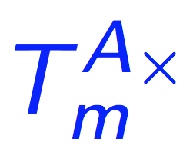
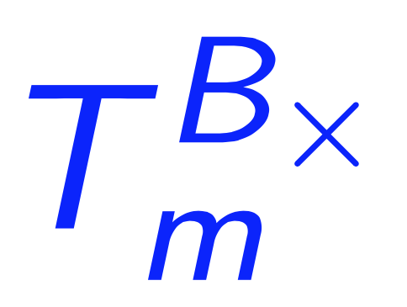
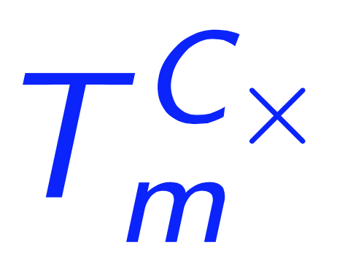
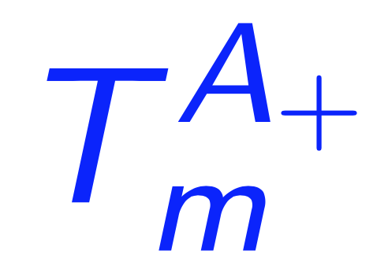
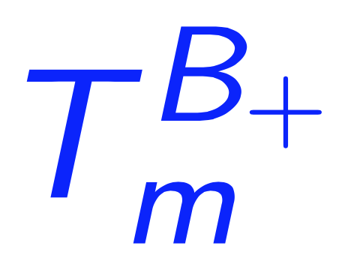
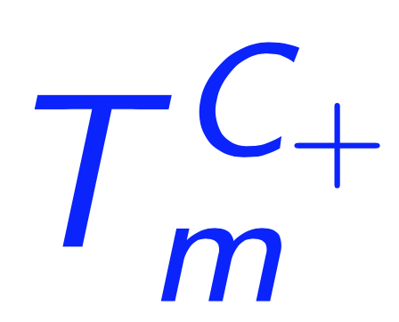
Memory Operations
Assumption
Simplified memory hierarchy model (fast caches + slow main memory)
R/W fast caches is overlapped with computations.
Dominant memory operations
Memory packing in DGEMM/adapted general operaton routine
Reading/writing submatrices of C in (adapted) routine
Reading/writing of the temporary buffer that are part of Naïve Strassen and AB Strassen.
Notes:
For memory operations,
(click)
We have the assumptions:
1. Architecture has a modern memory hierarchy with fast caches and slow main memory;
2. read/write fast caches can be overlapped with computations.
Based on the assumptions, the dominant parts of the memory operations are 3 parts:
(click)
1. Memory Packing in DGEMM or the adapted general operation routine: A \times, B \times
2. Reading/writing submatrices of C inside the adapted routine: C \times
3. Reading/writing of the temporary buffer that are part of Naïve Strassen and AB Strassen, outside the adapted routine: A plus, B plus, C plus
(click)
Here we give the formula to compute the time for memory operations. Each item needs to be multiplied by a coefficient.

Slide 48
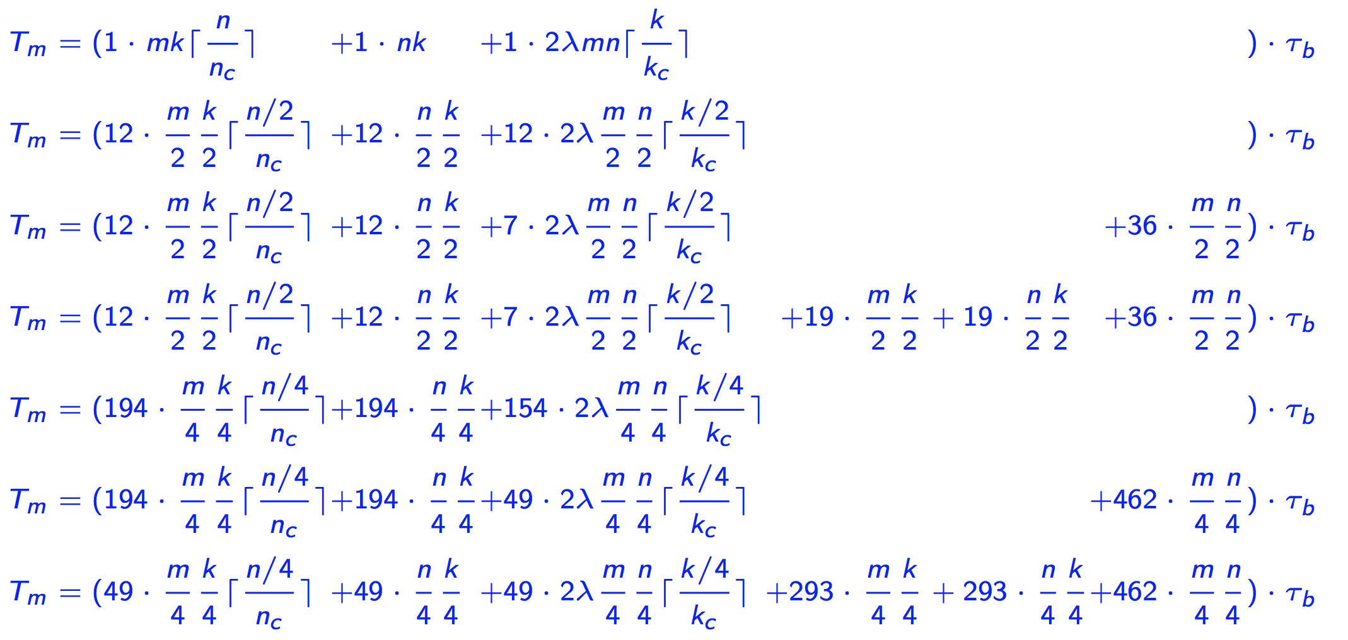
Memory Operations
DGEMM
One-level
ABC Strassen
AB Strassen
Naïve Strassen
λ∈ [0.5, 1], software prefetching efficiency
bandwidth
step function: periodical spikes
Notes:
Let’s dive into the details.
(click)
1. DGEMM only involves
--memory packing: 1st and 2nd item.
--Updating of submatrices of C: 3rd item
(click)
Further multiplied by tau_b:
Bandwidth: the amortized time for one double precision floating point number to move from slow memory to fast cache.
(click)
Lambda: prefetching, since we use software prefetching instructions to preload C matrix into the cache.
(click)
2. The different implementations of one-level Strassen are modeled with the equations here:
(click)
The step function here indicates that the performance curve will have “Periodical Spikes”

Slide 49
Memory Operations
DGEMM
One-level
ABC Strassen
AB Strassen
Naïve Strassen
Two-level
ABC Strassen
AB Strassen
Naïve Strassen
λ∈ [0.5, 1], software prefetching efficiency
bandwidth
step function: periodical spikes
Notes:
Comparing ABC Strassen with AB Strassen:
1. ABC Strassen avoids storing the intermediate matrix product M, since M resides in the register: it doesn’t have (36\cdot) term.
2. However, ABC Strassen increases the number of updating submatrices of C: the coefficient 12 is larger than 7 here.
when k is small, (36\cdot) term is the dominant part, ABC Strassen performs better;
when k is large, (12 term) is the dominant part, AB Strassen performs better.
(click)
The modeling for two-level Strassen is quite similar.
The submatrix size is m/4, n/4, k/4.

Slide 50
Modeled and Actual Performance on Single Core
Notes:
Now let’s take a look at …

Slide 51
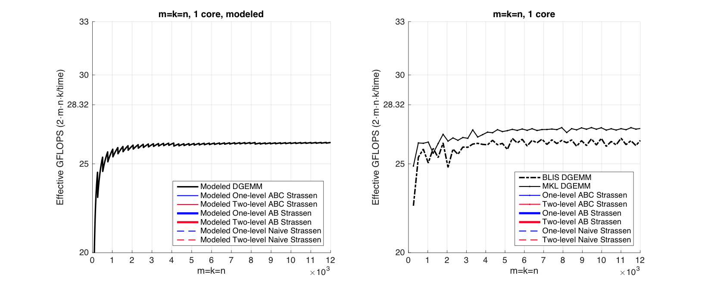
Observation (Square Matrices)
Modeled Performance
Actual Performance
Notes:
This is the observations for square matrices.
Left: modeled performance
Right: actual performance
For both graphs,
1. X-axis: problem size for square matrix;
2. Y-axis: the effective GFLOPS;
3. Y-axis ranges from 20-32: make the performance graph more readable. --zoom-in
4. 28.32: theoretical peak performance
For the actual performance, we have two curves here:
the solid black line: MKL DGEMM
MKL: Intel implementations of BLAS interface;
MKL DGEMM: represents the state-of-the-art GEMM performance on Intel processors.
2. The dashed black line: BLIS DGEMM
this is our baseline.
Period spikes

Slide 52
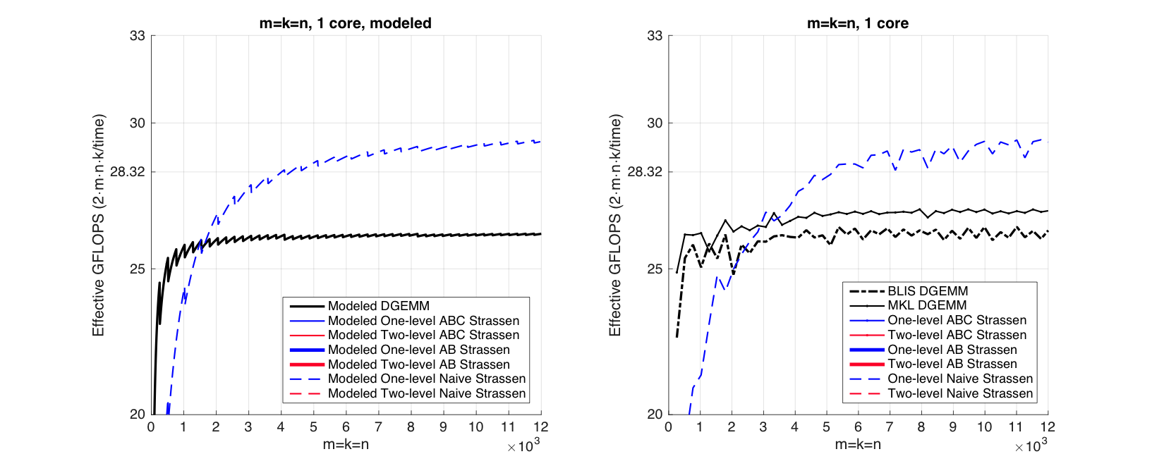
Observation (Square Matrices)
Modeled Performance
Actual Performance
Notes:
The blue dashed line represents the performance of one-level Naïve implementation for Strassen algorithm.
Outperform point: 2500

Slide 53
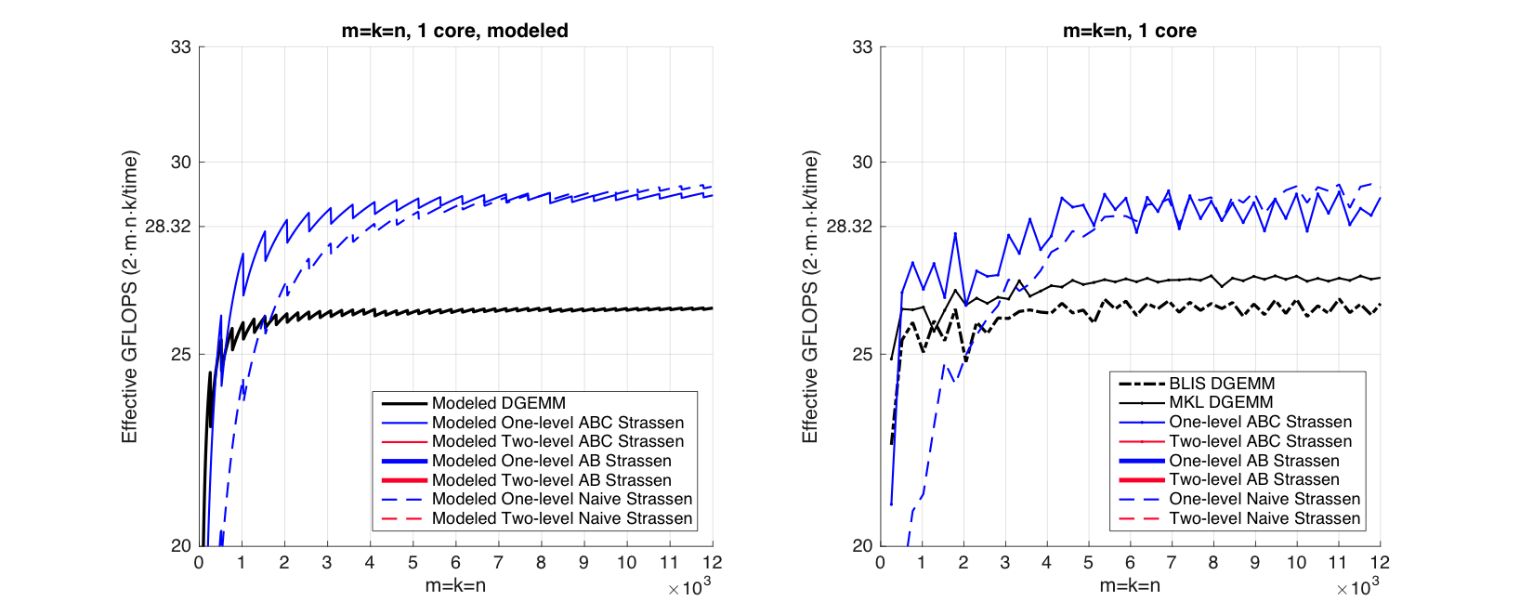
Observation (Square Matrices)
Modeled Performance
Actual Performance
Notes:
The solid blue line: ABC Strassen
For small problem size:
Ramp up much faster than Naïve Strassen.
500

Slide 54
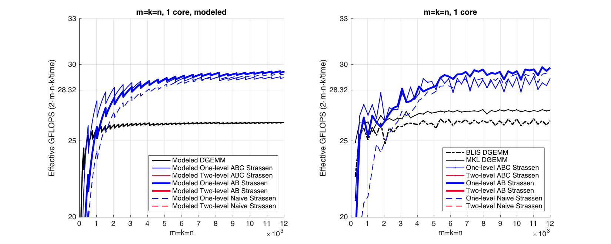
Observation (Square Matrices)
Modeled Performance
Actual Performance
Notes:
The thick blue line is AB strassen
For large problem size…
It outperforms both ABC and Naïve Strassen

Slide 55
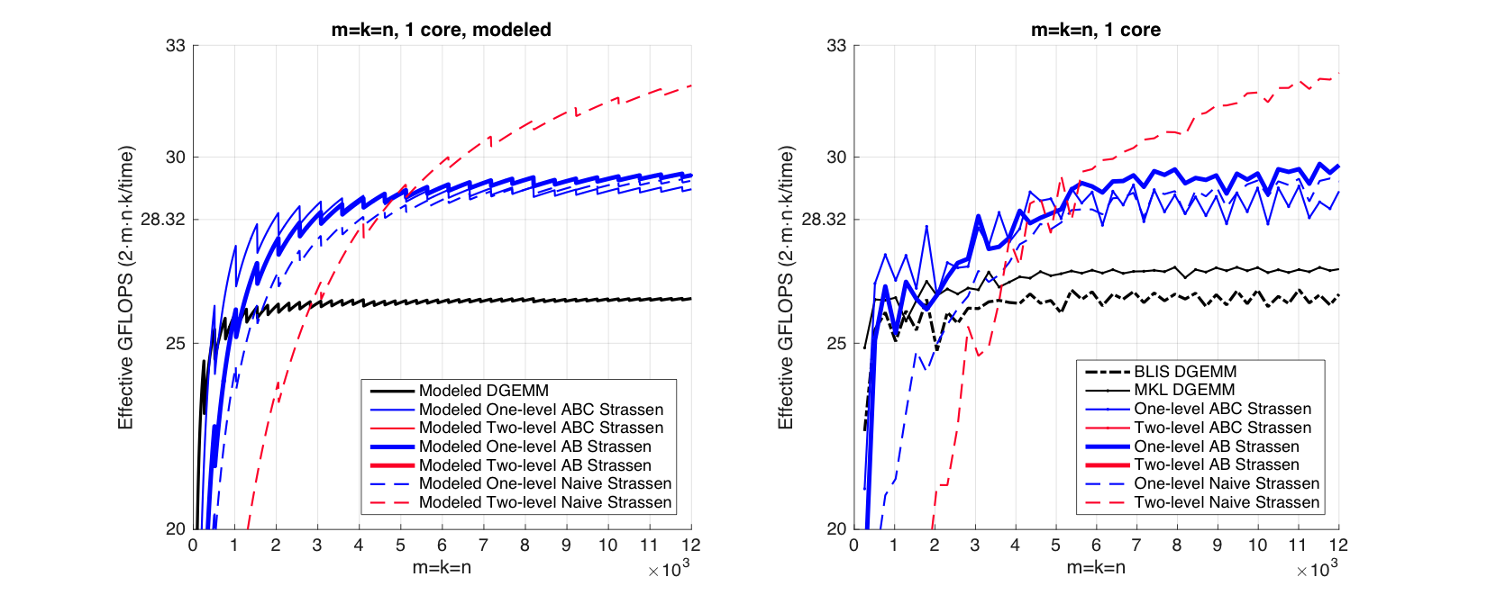
Observation (Square Matrices)
Modeled Performance
Actual Performance
Notes:
Performance for Two-level Strassen is similar:
Here is the performance curve for the Two-level Naïve Strassen

Slide 56
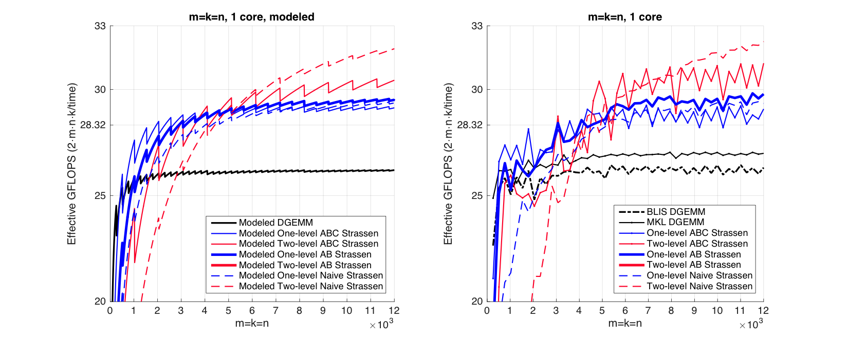
Observation (Square Matrices)
Modeled Performance
Actual Performance
Notes:
Then the performance curve for two-level ABC Strassen

Slide 57
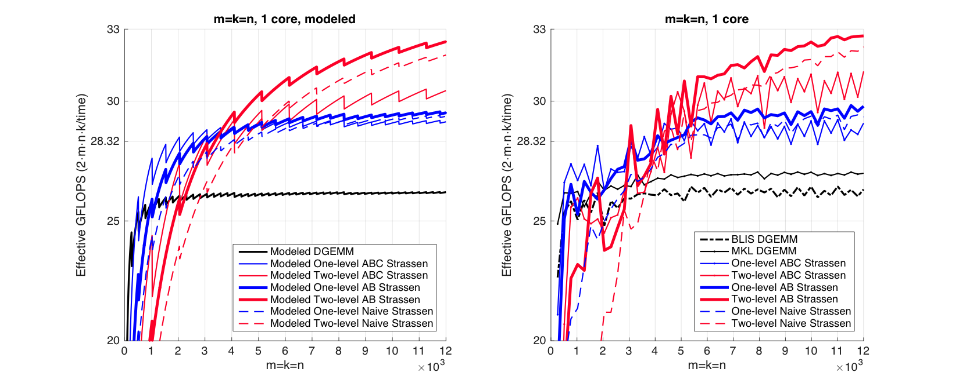
Observation (Square Matrices)
Modeled Performance
Actual Performance
Notes:
And the performance curve for two-level AB Strassen.
Basically, our performance model matches the actual performance, because it catches the dominant parts of the arithmetic operations and memory operations.

Slide 58
Observation (Square Matrices)
Modeled Performance
Actual Performance
26.0%
13.1%
Theoretical Speedup over DGEMM
One-level Strassen (1+14.3% speedup)
8 multiplications → 7 multiplications;
Two-level Strassen (1+30.6% speedup)
64 multiplications → 49 multiplications;
Notes:
Speedup of 1-level and 2-level Strassen.
Recall theoretical speedup

Slide 59
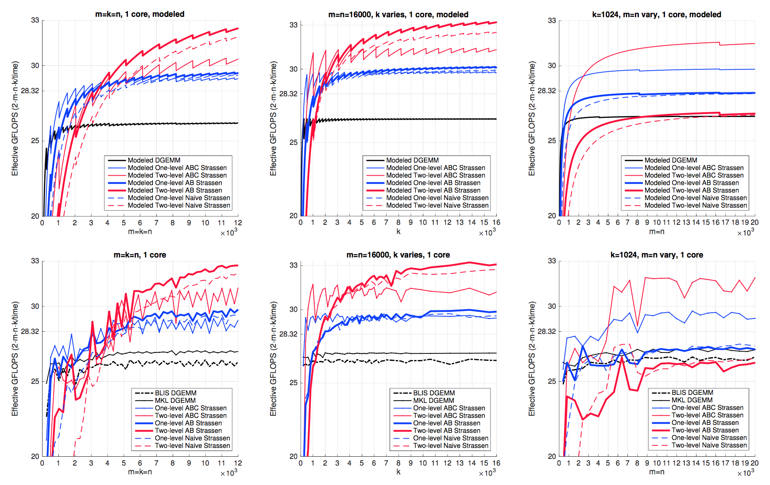
Observation (Square Matrices)
Both one-level and two-level
For small square matrices, ABC Strassen outperforms AB Strassen
For larger square matrices, this trend reverses
Reason
ABC Strassen avoids storing M (M resides in the register)
ABC Strassen increases the number of times for updating submatrices of C
Notes:
Switch point: 500, instead of 2000.
(click)
Reasons

Slide 60
n_{C}
5th loop around micro-kernel
n_{C}
n_{C}
5th loop around micro-kernel
n_{C}
C_{j}
A
B
D_{j}
Y
W
n_{C}
n_{C}
n_{C}
n_{C}
+=
C_{j}
+=
X
V_{j}
4th loop around micro-kernel
4th loop around micro-kernel
C_{j}
A_{p}
k_{C}
B_{p}
D_{j}
Y_{p}
k_{C}
W_{p}
+=
C_{j}
+=
X_{p}
V_{p}
k_{C}
k_{C}
~
~
3rd loop around micro-kernel
Pack B_{p} → B_{p}
3rd loop around micro-kernel
Pack V_{p} + εW_{p} → B_{p}
C_{i}
A_{i}
~
D_{i}
m_{C}
Y_{i}
~
m_{C}
m_{C}
B_{p}
C_{i}
X_{i}
B_{p}
m_{C}
+=
+=
~
~
Pack A_{i}→ A_{i}
Pack X_{i} + δY_{i}→ A_{i}
n_{R}
2nd loop around micro-kernel
~
n_{R}
~
n_{R}
2nd loop around micro-kernel
~
n_{R}
~
A_{i}
B_{p}
A_{i}
B_{p}
C_{i}
m_{R}
D_{i}
m_{R}
+=
+=
k_{C}
C_{i}
k_{C}
n_{R}
1st loop around micro-kernel
n_{R}
1st loop around micro-kernel
m_{R}
+=
m_{R}
+=
Update C_{ij}
k_{C}
Update C_{ij} , D_{ij}
k_{C}
micro-kernel
micro-kernel
main memory
1
main memory
1
L3 cache
+=
L3 cache
+=
L2 cache
1
L2 cache
1
L1 cache
L1 cache
registers
registers
Notes:
Intuitively, in the micro-kernel, ABC Strarssen stores the intermediate result M in the register, but it needs to update multiple submatrices of C. Here it needs to update 2 instead of 1.

Slide 61
Observation (Rank-k Update)
What is Rank-k update?
n
k
n
m
m
Notes:
We just evaluated the performance for square matrices on a single core. Now let’s look at the performance for the matrix multiplication of a special shape: rank-k update.
(click)
Rank-k update is a special shape when m, n >> k.

Slide 62
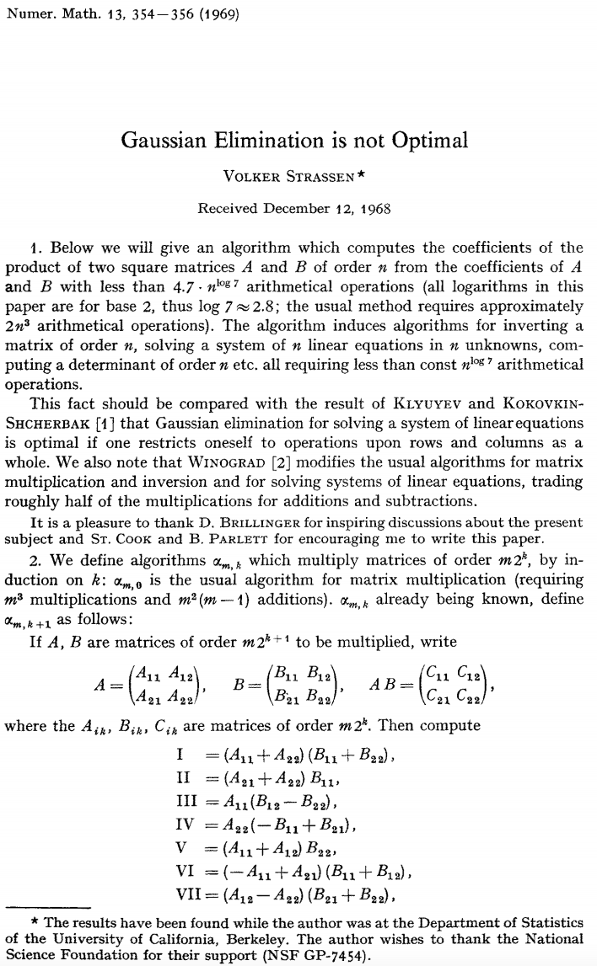
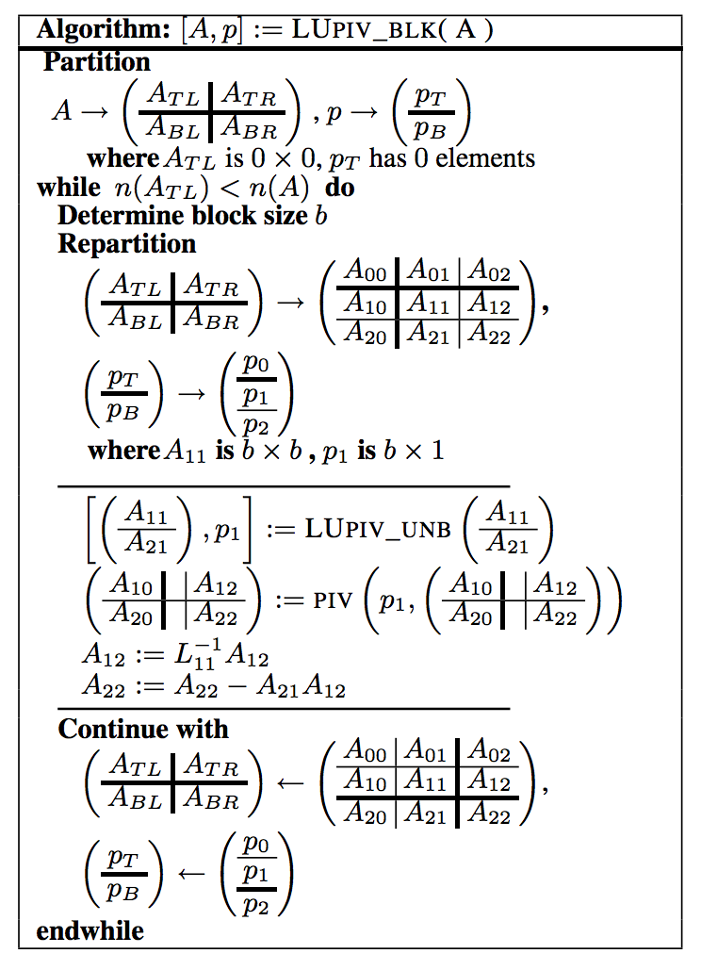
Observation (Rank-k Update)
Importance of Rank-k update
Blocked LU with partial pivoting (getrf)
A₁₂
A₂₁
A₂₂
Notes:
It has many applications.
(click)
We just look at the original Strassen paper. The first application for Strassen algorithm is for Guassian Elimination, i.e. solving the linear system
(click)
The equivalent form to use gaussian elimination to solve a linear system is to decompose the coefficient matrix into the product of a lower triangular and an upper triangular matrix.
This process is called LU decomposition, or getrf routine in the Linear Algebra package library.
This is the algorithm for solving LU decomposition. The dominant part is a GEMM operation.
(click)
We draw the shape of A12, A21, and A22 here.

Slide 63
Observation (Rank-k Update)
Importance of Rank-k update
A₁₂
+=
×
A₂₂
A₂₁
Notes:
As you see, this step is actually the matrix multiplication of special shapes, or what we call rank-k update.

Slide 64
Observation (Rank-k Update)
Importance of Rank-k update
Blocked LU with partial pivoting (getrf)
A₁₂
A₂₁
A₂₂
Notes:
Rank-k update is very common in many applications.
LU decomposition is just one example.
You can see the original Strassen paper targets at this as an application.
However, the conventional implementation, doesn’t do well.
Let’s look at the performance graph for rank-k update.

Slide 65
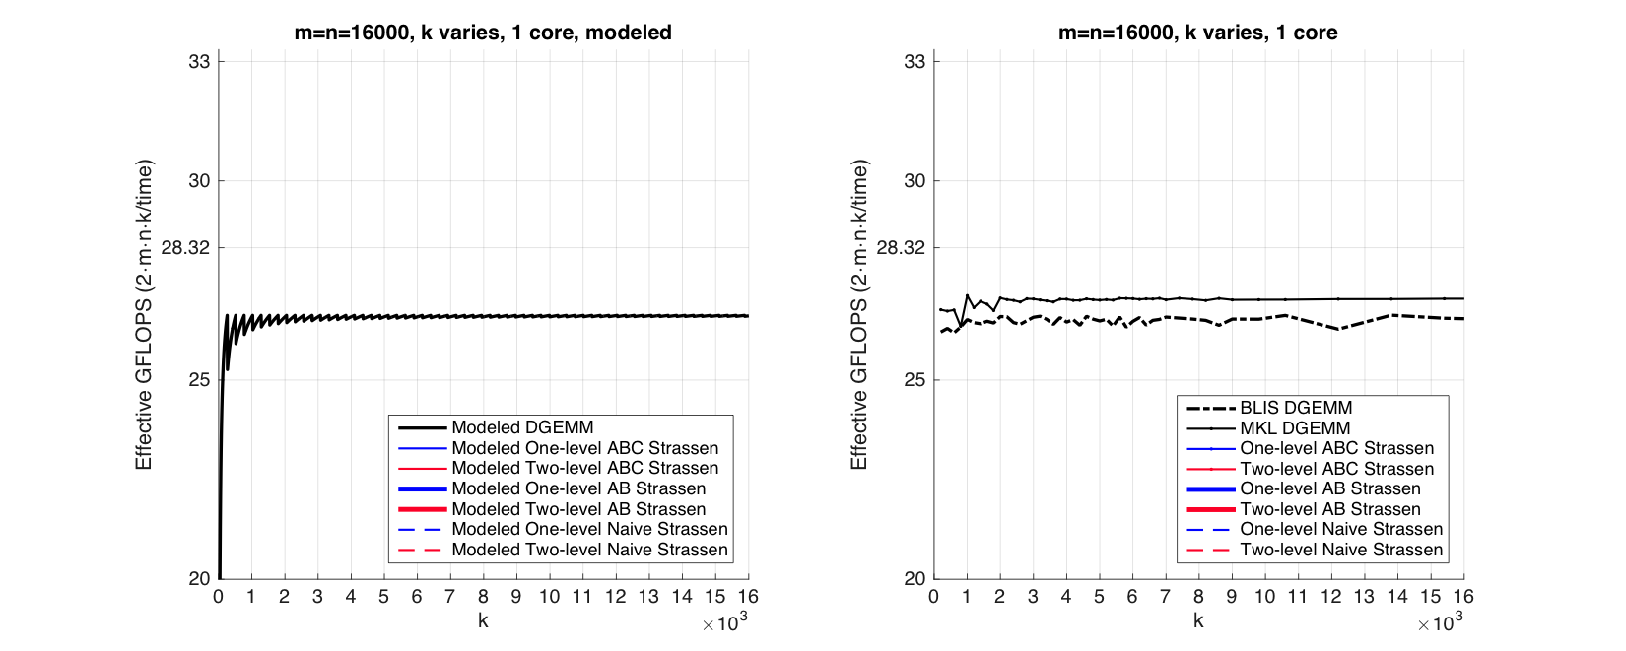
Observation (Rank-k Update)
Modeled Performance
Actual Performance
Notes:
Here we show the performance graph of rank-k update for modeled performance and actual performance on a single core.
X-axis, y-axis are the same as square matrices.
We fix m, n to 16000, and we vary k;
Black solid line: MKL DGEMM
Black dashed line: BLIS DGEMM. This is our baseline.

Slide 66
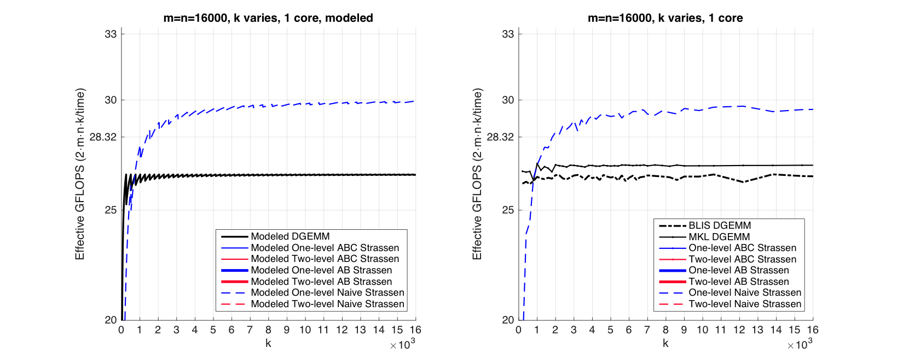
Observation (Rank-k Update)
Modeled Performance
Actual Performance
Notes:
Blue dashed line: 1-level Naïve Strassen

Slide 67
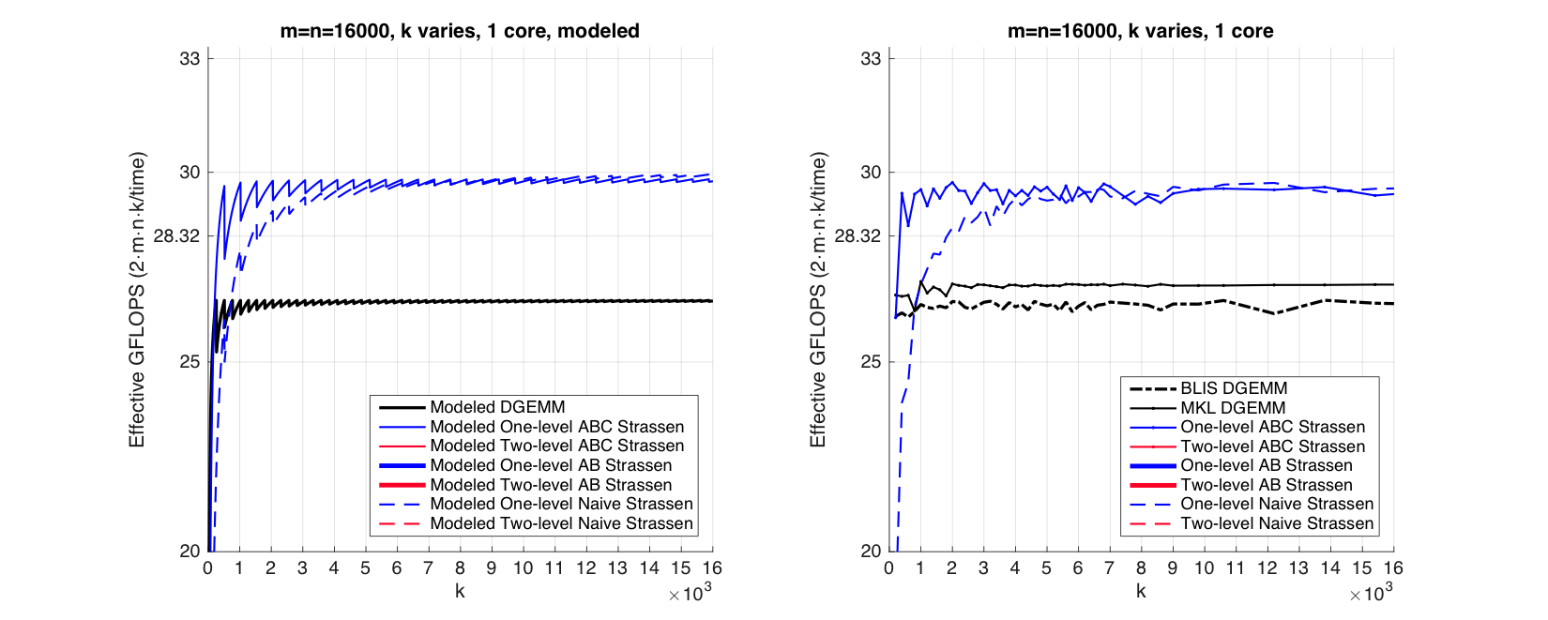
Observation (Rank-k Update)
Modeled Performance
Actual Performance
Notes:
Blue solid line: 1-level ABC Strassen
You can observe that ABC Strassen ramp up much faster than the naïve implementation.
Even k is quite small for rank-k update, ABC Strassen can reach very high performance

Slide 68
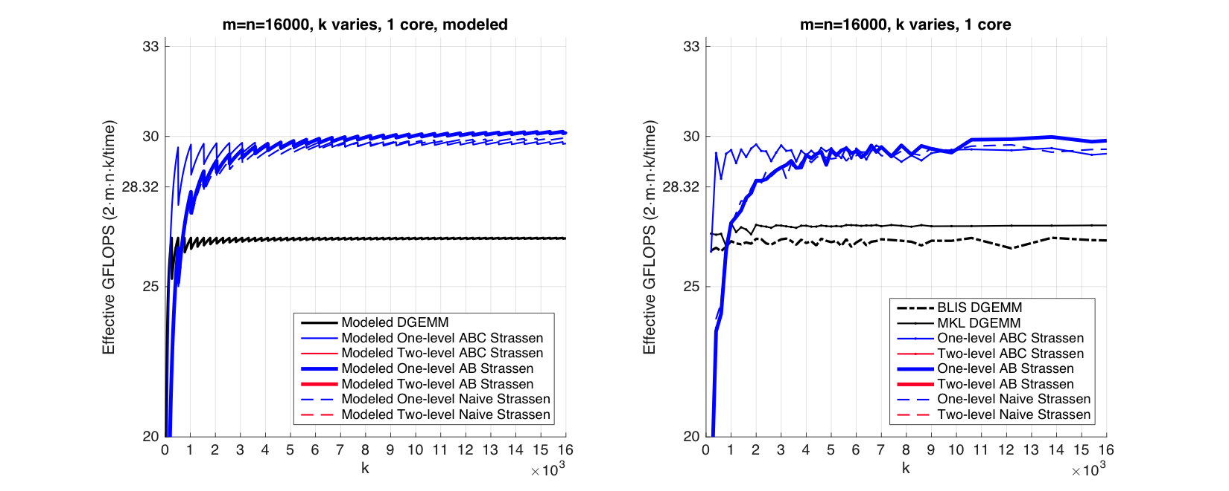
Observation (Rank-k Update)
Modeled Performance
Actual Performance
Notes:
Blue thick line is 1-level AB strassen.
It has similar performance with Naïve Strassen, because it also needs to store the intermediate product matrix Mi in memory.

Slide 69
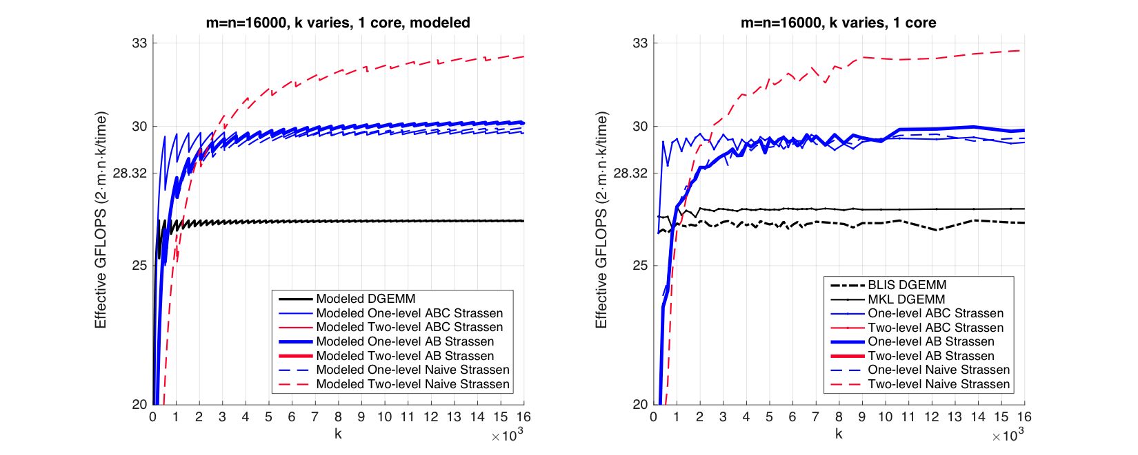
Observation (Rank-k Update)
Modeled Performance
Actual Performance
Notes:
Two-level Strassen is similar:
Here is the performance curve for the Two-level Naïve Strassen

Slide 70
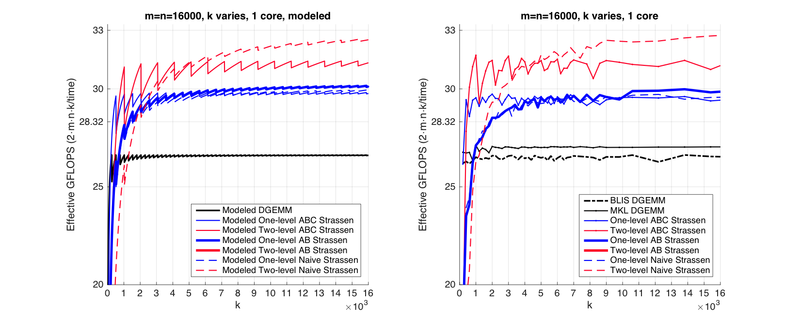
Observation (Rank-k Update)
Modeled Performance
Actual Performance
Notes:
And the performance curve for the Two-level ABC Strassen
The periodical spikes are quite obvious here.

Slide 71

Observation (Rank-k Update)
Modeled Performance
Actual Performance
Notes:
Here is the performance curve for the Two-level AB Strassen.

Slide 72
Observation (Rank-k Update)
For k equal to the appropriate multiple of k_{C}, ABC Strassen performs dramatically better than the other implementations
k = 2k_{C} for one-level Strassen
k = 4k_{C} for two-level Strassen
Reason:
ABC Strassen avoids forming the temporary matrice M explicitly in the memory (M resides in register), especially important when m, n >> k.
Notes:
Observation: (in slides)
Ivy Bridge: kC=256
(click)
Reason:
When m and n are larger than k, we don’t need to form M explicitly, that is a very large m x n matrix. We save the memory overhead by this way.
In the formula,
(Point to the formula)
When k is only 2kc, and m, n are much larger than k, the 2\lambda term is quite small, but the 36 \cdot m/2 is the dominant part.
//When k = 2 kc / 4 kc, and m, n are much larger than k, the panel panel multiplication (for submatrices in rank-k updates) can itself reach the peak performance.

Slide 73
Bottom line: A different implementation may have its advantages depending on the problem size

Slide 74
Outline
Conventional Matrix-matrix multiplication
Strassen’s Algorithm Reloaded
High-performance Implementations
Theoretical Model and Analysis
Performance Experiments
Conclusion
Notes:
OK, let’s verify our performance model and our insights with our performance experiments.

Slide 75
Single Node Experiment
Notes:
First, we will show the performance on a single node.

Slide 76

1 core
5 core
10 core
Square Matrices
Rank-k Update
Notes:
The experiments are done on a Ivy Bridge CPU.
We run the experiment for 1-core, 5-core, 10-core. All within the same socket.
1st row: Square matrices; 2nd row: Rank-k update
1st column, 2nd column, 3rd column: 1 core, 5 core, 10 core.
We have already seen the perf graphs in the 1st column for single core in the previous slides.
The perf graphs in the 2nd and 3rd columns show that for 5 core, or 10 core, the relative performance is similar to 1-core.
However, the performance win of Strassen over the standard matrix multiplication (GEMM) for 5-core, 10-core is not as large as 1-core.
This is because the memory contention issues for multi-core.
//Memory bandwidth contention affects the performance of the various Strassen implementations, reducing the benefits relative to a standard DGEMM implementations.

Slide 77
Many-core Experiment
Notes:
Next, we show the performance result for many-core architecture.

Slide 78


Intel® Xeon Phi™ coprocessor (KNC)
Notes:
We do the experiment on Intel KNC (Knight Landing Corner).
It has 61 cores, or 244 hyper threads.
BLIS itself just use 240 hyper threads, or 60 cores.
We show the performance graph for rank-k update,
when we fix m,n to 15000, and vary k.
The black dashed line with X symbol is the BLIS DGEMM implementation,
and blue line is 1-level ABC Strassen. We show the speedup for Xeon Phi with 1-level ABC Strassen.
However, the black solid line and black dash-dot line is the MKL performance for 240 threads and 244 threads.
//The BLIS GEMM implementation used to be highly competitive with MKL DGEMM.
//But the recent improvements on MKL DGEMM shows that BLIS DGEMM needs an update.
We believe that if we build our ABC Strassen on Intel MKL DGEMM implementation, we can get similar speedup over MKL DGEMM.

Slide 79
Distributed Memory Experiment
Notes:
Next, we show the performance result for distributed memory.

Slide 80

Accelerating SUMMA algorithm with Strassen
Rank-k update
B_{p}
+=
×
A_{p}
*Robert A. van de Geijn, and Jerrell Watts. "SUMMA: Scalable universal matrix multiplication algorithm." Concurrency-Practice and Experience 9, no. 4 (1997): 255-274.
Notes:
We implement the scalable universal matrix multiplication algorithm (SUMMA) with MPI. This is a distributed memory version of GEMM.
We demonstrate how we use Strassen to accelerate SUMMA.
(click)
SUMMA distributes the computation to a mesh of MPI processes using a 2D block cyclic distribution.
(click)
The multiplication is broken down into a sequence of rank-k updates.
each Ap consists of k columns and each Bp consists of k rows.
(click)
For each rank-k update Ap is broadcast to rows of the mesh and Bp is broadcast to columns of the mesh

Slide 81
Accelerating SUMMA algorithm with Strassen
Rank-k update
4k_{C}
B_{p}
+=
×
B
A_{p}
C
A
4k_{C}
*Robert A. van de Geijn, and Jerrell Watts. "SUMMA: Scalable universal matrix multiplication algorithm." Concurrency-Practice and Experience 9, no. 4 (1997): 255-274.
Notes:
Each node will locally perform a rank-k update with the arriving submatrices
(click)
to update the local block of C.
(click)
If we perform these rank-k updates with k=4kC, then
Replacing the local node DGEMM with ABC Strassen would bring performance benefits theoretically.

Slide 82
Effective GFLOPS/socket
Weak Scalability
An algorithm maintains efficiency as the number of processors varies and problem size/processor is fixed.
SUMMA is weakly scalable
MPI process number, or socket number
Problem size/socket
Notes:
We do the weak scalability performance experiment to verify our ideas.
(click)
1. A parallel algorithm is weakly scalable when it can maintain efficiency as the number of processors vary and problem size/processor is fixed.
2. SUMMA is weakly scalable in theory.
(click)
In our experiment, we run one MPI process per socket.
So the number of processors is actually the socket number.
(click)
The problem size/processor is actually …
(click)
And the efficiency is “Effective GFLOPS/socket” in our context.
//We attain the thread parallelism among the ten cores in a socket within BLIS, MKL, or any of our Strassen implementations.

Slide 83

Problem size/socket is fixed to 16000
Efficiency
Notes:
(click)
We choose the MPI mesh of processes to be square.
(click)
The local problem size is fixed to equal to 16000,
(click)
so that the global size becomes 16000xN.
(click)
x-axis, the MPI process number, or socket number
(click)
y-axis, the effective GFLOPS / socket, or efficiency
Black dash line: BLIS DGEMM: Baseline
Black solid line shows the perf for MKL DGEMM
This line is almost flat (degrade only a little), so it shows the efficiency can be maintained when thve number of processors varies and problem size/processor is fixed.
In other words, SUMMA is weakly scalable.

Slide 84

Notes:
Here is the performance curve for 1-level and 2-level Naive strassen. Worse than DGEMM.
//Dash line with circle marker

Slide 85

Notes:
Here is the performance curve for 1-level and 2-level AB strassen. Also Worse than DGEMM.
//Dash-dot line with triangular marker
//The performance is worse than Naïve Strassen, because n_C

Slide 86

Notes:
Here is the performance curve for 1-level and 2-level ABC Strassen. They outperform all other implementations.
The reason is that ABC is a natural choice when rank-k updates are performed with k=4k_C.
What this experiment shows is that the benefit of using our Strassen implementations can be easily transferred to other algorithms that are rich in large rank-k updates.

Slide 87
Outline
Conventional Matrix-matrix multiplication
Strassen’s Algorithm Reloaded
High-performance Implementations
Theoretical Model and Analysis
Performance Experiments
Conclusion
Notes:
OK. Let’s come to the conclusion part.

Slide 89
To achieve practical high performance
of Strassen’s algorithm…...
Conventional Implementations
Our Implementations
Matrix Size
Must be large
Matrix Shape
Must be square
Memory movement
No Additional
Workspace
Padding
Buffers
Parallelism
Usually task parallelism
Can be data parallelism
Notes:
In summary, to achieve practical high performance of Strassen’s algorithm, our implementations
(click)
1. Outperform classical matrix multiplication even for small square matrices
(click)
2. Achieve high performance for rank-k updates
--A case of matrix multiplication frequently used in applications. e.g. LU factorization, SUMMA for distributed memory GEMM
(click)
3. Don’t need additional workspace.
--Utilize the packing buffer inside the conventional high-performance implementation of matrix multiplication
--The computation is organized so that no workspace is required beyond buffers already incorporated in the high-performance traditional matrix multiplication.
--Plug-compatible with the standard GEMM interface supported by BLAS.
(click)
4. Easy to parallelize.
--Adopt the same parallel scheme with conventional matrix multiplication

Slide 90
Summary
Present novel insights into the implementations of Strassen
Develop a family of Strassen algorithms
Derive a performance model that predicts the run time of the various implementations
Demonstrate performance benefits for single-core, multi-core, many-core, and distributed memory implementations
Notes:
1. We present novel insights into the implementations of Strassen
2. We develop a family of Strassen algorithms
3. We derive a performance model that predicts the run time of the various implementations
4. We demonstrate performance benefits for single-core, multi-core, many-core, and distributed memory implementations

Slide 91
Thank you!
Jianyu Huang
http://www.cs.utexas.edu/~jianyu
Get BLIS:
http://github.com/flame/blis

